Slide 1
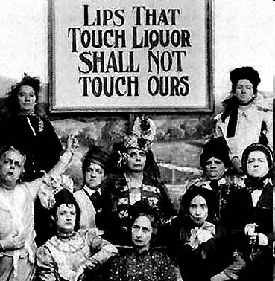

Slide 2
18th Amendment
Context: The US Senate passed the 18th Amendment on December 18, 1917. It was ratified on January 16, 1919, after 36 states approved it. The 18th Amendment, and the enforcement laws accompanying it, established Prohibition of alcohol in the United States. Several states already had Prohibition laws before this amendment. It was eventually repealed by the 21st Amendment on December 5, 1933. It is the only amendment that has ever been completely repealed.
Section 1. After one year from the ratification of this article the manufacture, sale, transportation, importation or exportation of intoxicating liquors in the United States and all its territory is hereby prohibited.
Section 2. The Congress and the States shall both have power to enforce this article by appropriate legislation.
Section 3. This article shall have no power unless it shall have been ratified as an amendment to the Constitution by the legislatures of the States, as provided in the Constitution, within seven years from the date of the submission to the States by the Congress.
1. What is your first reaction to the 18th amendment?
2. Do you think this amendment could be passed today? Why or why not?
3. Why do you think some Americans in 1918 might have wanted this amendment?

Slide 3
Prohibition and Health Source: Statement read at the Eighth Annual Meeting of the National Temperance Council, Washington D.C., September 20, 1920. The National Temperance Council was created in 1913 to work for Prohibition.
Alcohol poisons and kills; Abstinence and Prohibition save lives and safeguard health. Dr. S.S. Goldwater, formerly Health Commissioner of New York City, stated the decision of science, the final opinion of our nation after a hundred years of education upon the subject of alcohol.
“It is believed that less consumption of alcohol by the community would mean less tuberculosis, less poverty, less dependency, less pressure on our hospitals, asylums and jails.”
“Alcohol hurts the tone of the muscles and lessens the product of laborers; it worsens the skill and endurance of artists; it hurts memory, increases industrial accidents, causes diseases of the heart, liver, stomach and kidney, increases the death rate from pneumonia and lessens the body’s natural immunity to disease.”
Justice Harlan speaking for the United States Supreme Court, said: “We cannot shut out of view the fact that public health and public safety may be harmed by the general use of alcohol.”
What does the National Temperance Council claim is caused by alcohol?
Do you find these claims convincing? Do you think people at the time found these claims convincing? Explain.

