Slide 1
IMPERIALISM CARTOONS
Standard 7-4
The student will demonstrate an understanding of the impact of imperialism throughout the world in the late nineteenth and early twentieth centuries.

Slide 2
Cartoon # 1

Slide 3
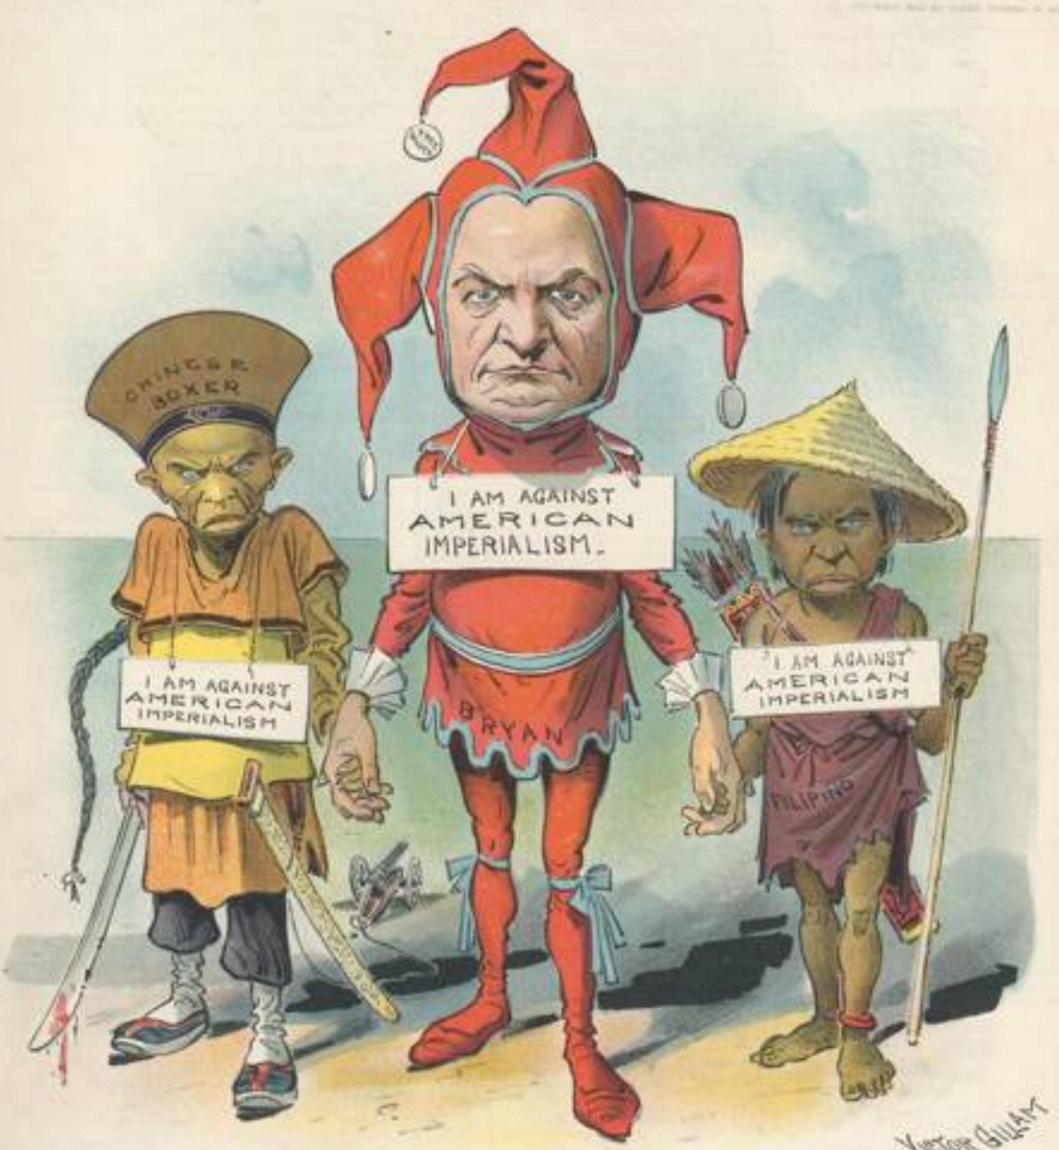

Slide 4
Cartoon # 2

Slide 5
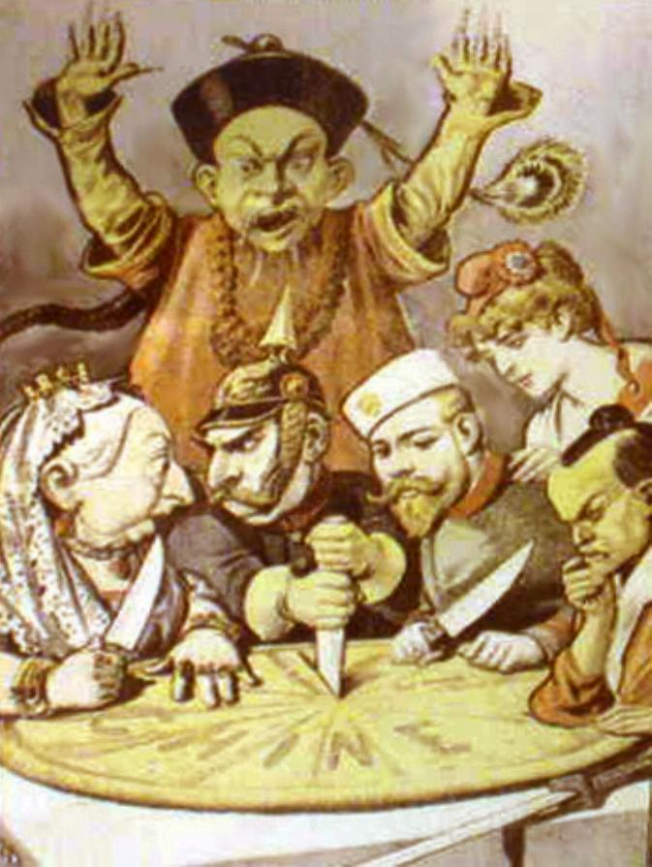

Slide 6
Cartoon # 3

Slide 7
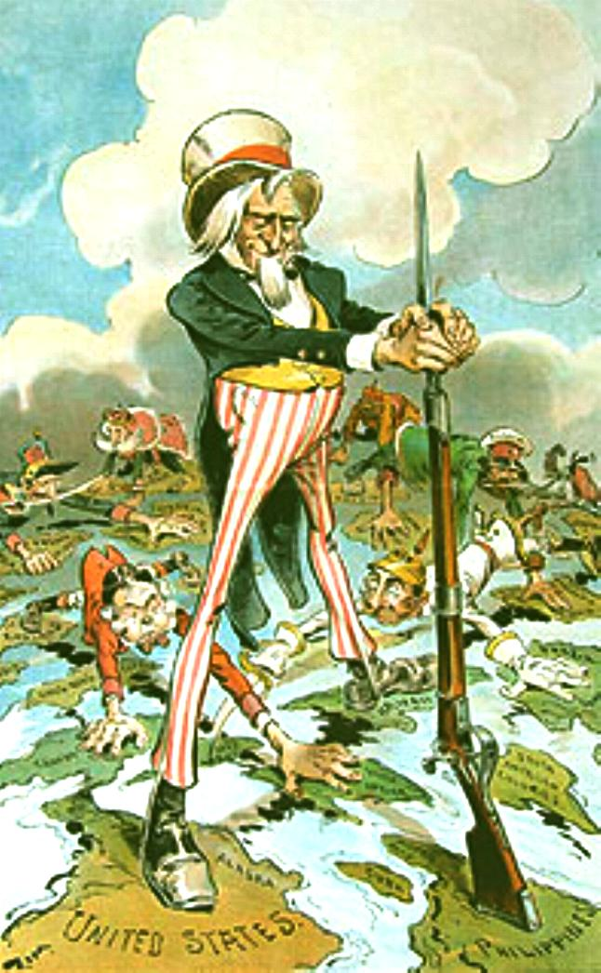

Slide 8
Cartoon # 4

Slide 9
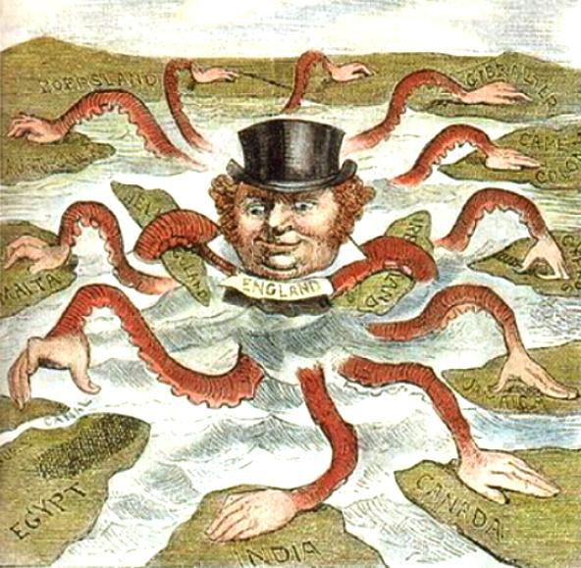

Slide 10
Cartoon # 5

Slide 11
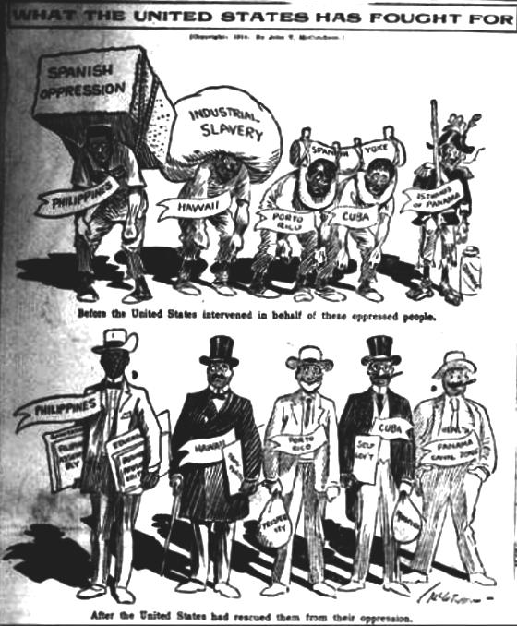

Slide 12
Cartoon # 6

Slide 13
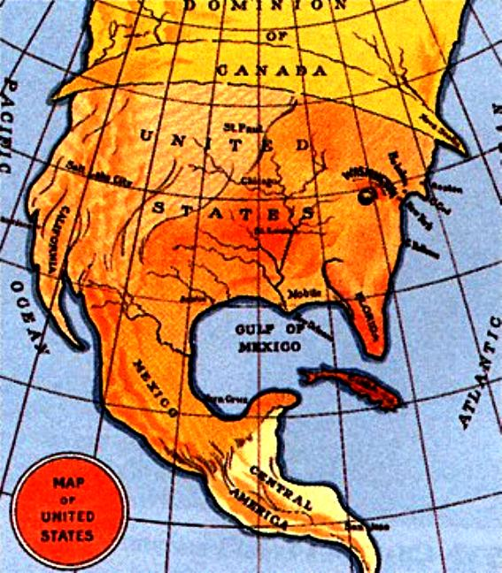

Slide 14
Cartoon # 7

Slide 15
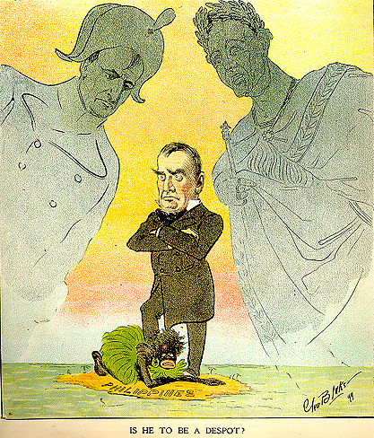

Slide 16
Cartoon # 8

Slide 17
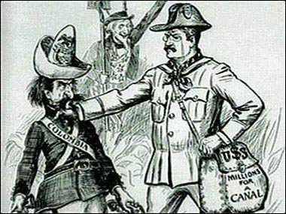

Slide 18
Cartoon # 9

Slide 19
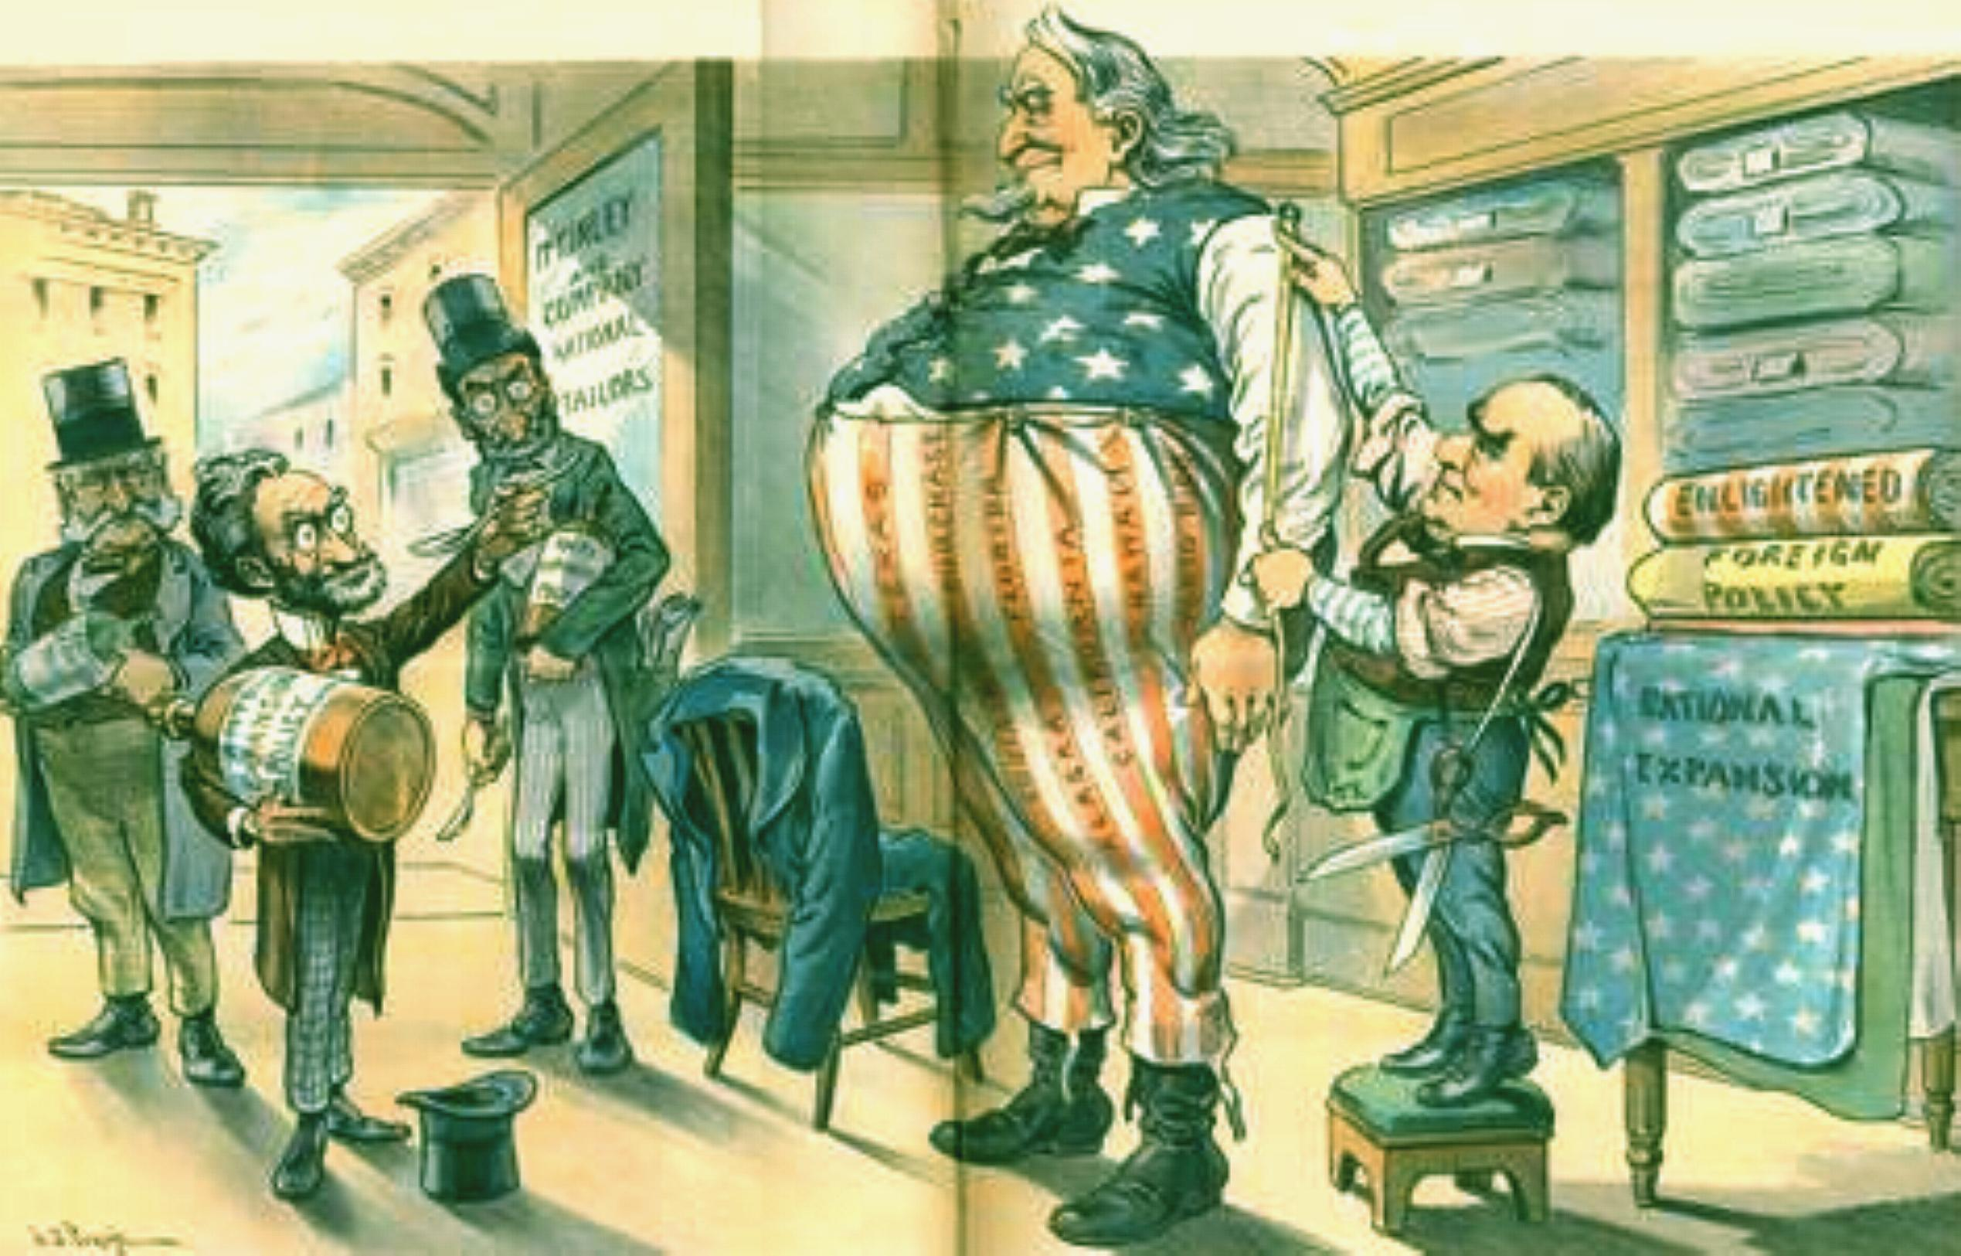

Slide 20
Cartoon # 10

Slide 21
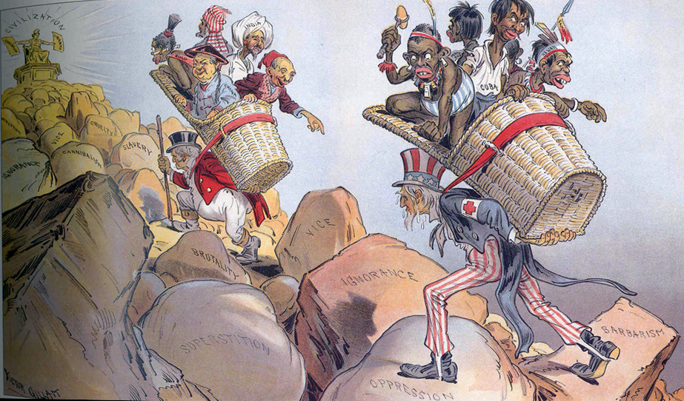

Slide 22
Cartoon # 11

Slide 23
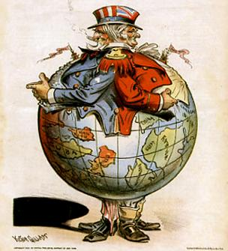

Slide 24
Your Assignment:
What is occurring in the cartoon?
What symbols or symbolism is being used? (i.e. US as Uncle Sam?)
Is there a caption? What does it say?
What year is the cartoon?
What can we infer from the symbolism, occurrence, and context/year?

Slide 25
Create Your Own Cartoon
Create a colorful cartoon that has a message dealing with imperialism in any place we have discussed this unit.
You must also include a short explanation (2-3 complete sentences) on the message of your cartoon (either on the back of the page or on an attached sheet)

Slide 26
Possible Topics
Imperialism
Spanish American War
Hawaii
Alaska
Yellow Journalism
Puerto Rico
Philippine American War
Boxer Rebellion
Panama Canal
Open Door Policy
Foreign Policy
McKinley
Roosevelt
Taft
Wilson
Relate/compare one of these topics to a modern day issue
This is not an art project, but you will be graded on creativity and relevance to your topic
The most effective cartoon was a clever cartoon

Slide 27
Quality of Info for the explanation 10 points | All required information clearly related to the main topic, included consistent supporting details and/or examples. | All required information clearly related to the main topic, provided adequate supporting details and/or examples. | All required information clearly related to the main topic, provided some supporting details and/or examples. | Information related to the main topic, no details or examples provided. | Information had little or nothing to do with main idea.
Mechanics 5 points | No grammatical, spelling or punctuation errors observed. | Almost no grammatical, spelling or punctuation errors observed. | A few grammatical, spelling or punctuation errors observed. | Many grammatical, spelling or punctuation errors. | No observable effort in the area of mechanics.
Pictorial Representation 15 points | Picture clearly relates to the main topic and is colorful. | Picture relates to the main topic and is colorful. | Picture somewhat relates to the main topic and is colorful. | Picture is not related to the main topic. | No picture.
Category | 5 | 4 | 3 | 2 | 1

