Slide 1
THE PROGRESSIVE ERA
American History II - Unit 2

Slide 2
Review
What is the bully pulpit?
An office of high standing that allows the office holder to speak out and be heard → influence change!
What was the name of Roosevelt’s progressive reforms?
The Square Deal – aimed to restore economic opportunities to all Americans
What was Roosevelt’s stance on monopolies and trusts?
Trustbuster → Wanted to break them up (by political/judicial force if necessary)
How did Roosevelt view the environment/natural areas in the US?
Pushed for conservation of resources and environment (set aside some land for preservation and cultivate other lands)
Roosevelt invited which civil rights activist to DC on various occasions?
Booker T. Washington
Angered Du Bois, believed Washington’s strategies were too passive

Slide 3
2.5 – PROGRESSIVISM UNDER TAFT & WILSON
https://www.youtube.com/watch?v=YYthCK1HFqA

Slide 4
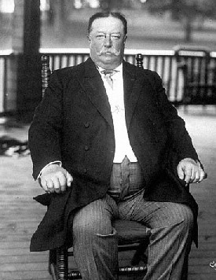
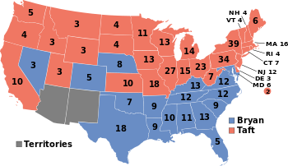
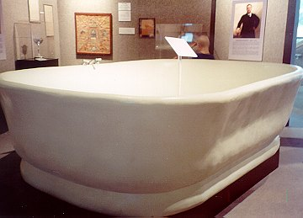
Taft Becomes POTUS 1908-1912
Roosevelt decides not to run again in 1908 – William Taft elected
Republican, cautiously progressive, did not take advantage of bully pulpit – felt as if in Roosevelt’s shadow
“When I am addressed as ‘Mr. President,’ I turn to see whether you [Roosevelt] are not at my elbow.”
Fun fact: Heaviest POTUS, only former POTUS to serve as a Supreme Court Justice
"Big Bill" was over 330 pounds and 6'2". Needing a big bathtub, he had a 7' long 41" wide tub installed that could accommodate 4 normal-sized men.

Slide 5
Taft Loses Support from Progressive Republicans
Taft and Tariffs
Taft and Public Land Conservation
Republican controlled HoR passed the Payne Bill – lowered tariffs
Democratic controlled Senate passed the Aldrich Bill – increased tariffs
Taft signed the Payne-Aldrich Tariff Act - provided for slight cuts to some tariffs
Criticized by Progressive Republicans
Taft campaigned to lower tariffs (staple of the progressive agenda)
Appointed Richard Ballinger (wealthy lawyer from WA) to Sec. of Interior
Anti-conservationist
Ballinger removed 1 million acres of federal land from the reserved list → opened it to private commercial development
Taft defended Ballinger
Progressive Republicans criticized Taft’s support of relationships between businesses and the gov’t

Slide 6
Republican Party Splits Over Taft
Taft’s cautious nature caused a rift in the Republican Party – couldn’t please either side
Conservative – maintain ties with political machines and big businesses
Progressives – regulate businesses and practice land conservation
1910 midterm elections – Democrats gained control of HoR
1910 – Roosevelt returns to US, recognizes his Square Deal and Republican Party in shambles → decides to run for 3rd term in 1912
Conservative Republicans – Taft
Progressive Republicans → Bull Moose Party - Roosevelt

Slide 7
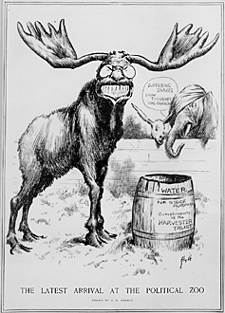
Bull Moose Party
Progressive Party = Bull Moose Party
Roosevelt claimed he was “as strong as a bull moose.”
Bull Moose Party Platform
Direct election of senators
All states need to adopt initiatives, referendums, and recalls
Women’s suffrage, workers’ comp, no child labor, gov’t regulation of business

Slide 8
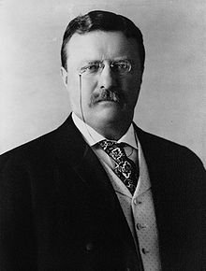
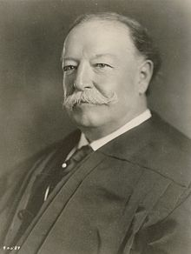
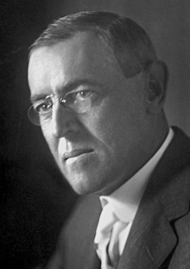
Election of 1912
Bull Moose Party (progressives) – Roosevelt
Called Taft a “fathead” with the brain of a “guinea pig”
Republicans – Taft
Called Roosevelt a “dangerous egotist”
Democrats – Woodrow Wilson (NJ governor)
“Don’t interfere when your enemy is destroying himself.”

Slide 9
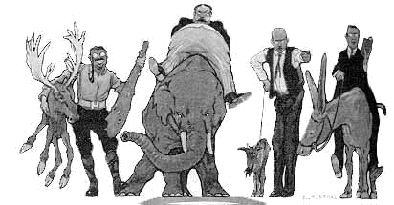
Election of 1912
Roosevelt | Taft | Debs | Wilson
Bull Moose (Progressive) | Conservative Republican | Socialist | Democrat
Strong gov’t role in economic affairs Supervise big business | Cautious progressivism Compromises | Called for an end to capitalism | Strong gov’t role in economic affairs, stronger antitrust laws Supported small business and free market competition

Slide 10
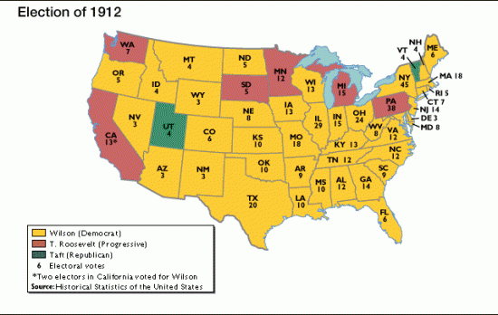
Election of 1912 (10 min)
Wilson = 28th POTUS

Slide 11
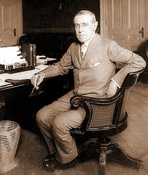
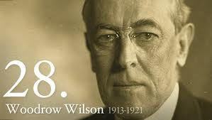
Woodrow Wilson https://www.youtube.com/watch?v=DVtkymxNFwA
Lawyer, president of Princeton University, NJ governor, 28th POTUS (1912-1920)
Democrat, favored direct primary, workers’ comp, regulation of railroads
“New Freedom,” - Wilson’s progressive reforms to attack the “triple wall of privilege:” 1) trusts, 2) tariffs, 3) high finance
Fun Fact: Said to have had dyslexia as a child, yet the only POTUS to hold an earned Ph.D.

Slide 12
Antitrust Measures
Clayton Antitrust Act of 1914
strengthened the Sherman Antitrust Act, prohibited corporations from buying other company’s stock if it would create a monopoly.
Declared strikes and union activity legal unless damage done by strikes could not be repaired
Federal Trade Commission Act of 1914
Established the Federal Trade Commission (FTC)
“Watchdog” agency with the power to investigate possible violations of regulation laws and required periodic reports from corporations.
Under Wilson, FTC administered over 400 cease-and-desist orders to companies for illegal practices.
“Without the watchful, resolute interference of the government, there can be no fair interplay between individuals and such powerful institutions as the trusts. Freedom today is something more than being left alone.” - Wilson

Slide 13
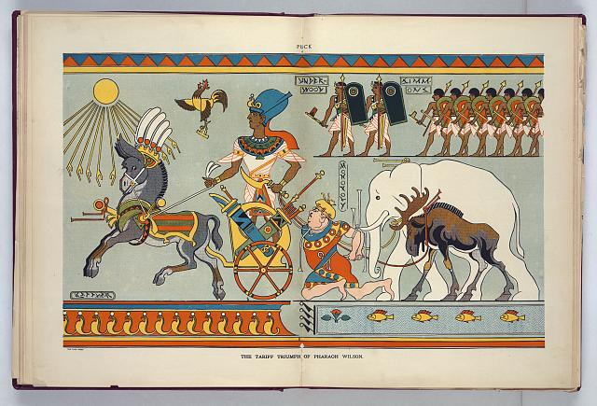
Reduction of Tariffs
Influenced Congress to lower tariffs through the Underwood Act which would greatly reduce tariff rates for the 1st time since the Civil War.
Faced opposition by big business lobbyists that wanted to keep tariffs to make more $.
Wilson used bully pulpit to convince Senate to cut tariff rates.
Lobby:
To try to influence (an official) to take a desired action

Slide 14
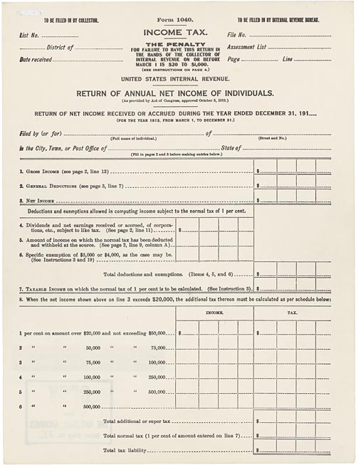
Reduction of Tariffs
Lower tariffs left a dent in US revenue
16th Amendment (1913): graduated income tax
larger incomes = more taxes while smaller incomes = fewer taxes
By 1917, federal gov’t received more $ from income tax than it ever did with tariffs
Today, income tax = federal gov’t’s main source of revenue.

Slide 15
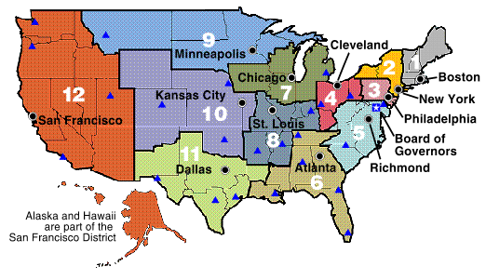
Financial Reform
Wilson wanted a way to quickly adjust the amount of $ in circulation to keep pace with the changing economy.
Federal Reserve System (1913)
Decentralized private bank system under federal control
Divided US in 12 districts, each with a Federal Reserve Bank that could issue currency in times of emergency or transfer $ to failing banks in its district → to prevent another “panic” due to collapsing banks

Slide 16
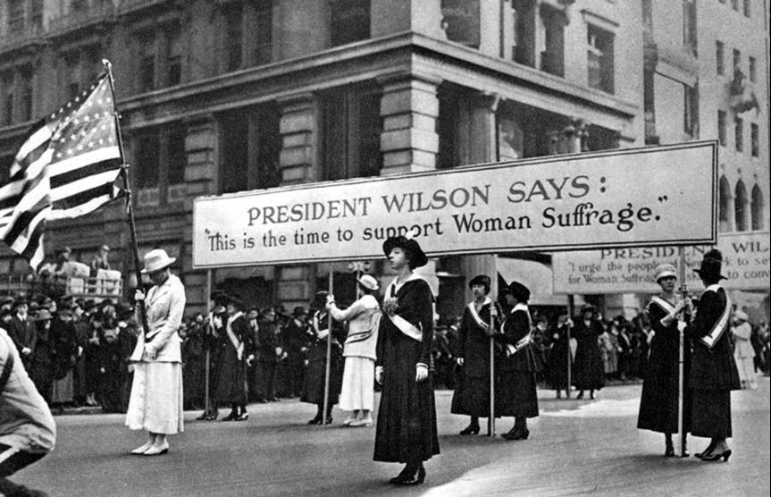
Women Gain the Vote
By 1915, many women…
Had higher ed degrees
Had been very active in reform movements
Were frustrated without a political voice to further enhance reform movements
Women employed new strategies
Door-to-door and street-corner speech tactics to raise awareness
Drew inspiration from GB’s women’s suffrage movement – heckled gov’t officials, publically spoke against the current gov’t
Organized marches and public events to raise awareness

Slide 17
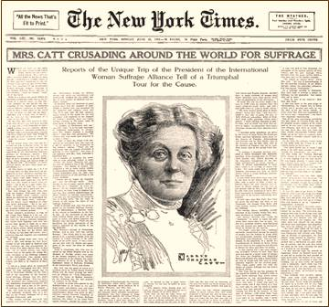
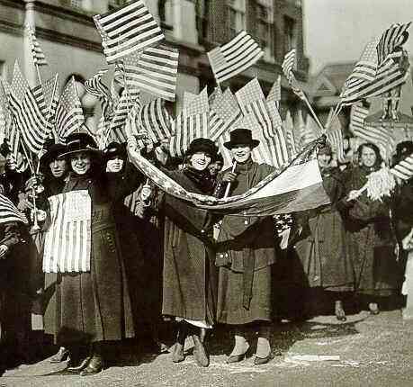
Women Gain the Vote
Carrie Chapman Catt – suffragist, Susan B. Anthony’s successor as president of the National American Woman Suffrage Association (1915)
Painstaking organization
Close ties between local, state, and national activists
Establish a wide base of support
Lobbying
Ladylike behavior
19th Amendment (1919) – women’s suffrage
US entrance in WWI in 1917 demonstrated women’s commitment to patriotic values – no longer could deny them the vote.

Slide 18
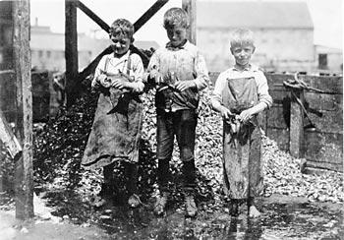
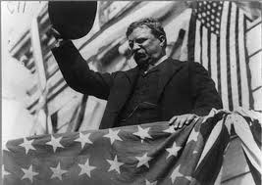
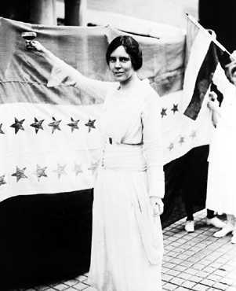
Limits to Progressivism
Civil Rights – biggest failure of the Progressive Era
The Progressive Era did not include agendas for expanding civil rights for African Americans
Progressive presidents claimed to support civil rights, however no civil rights legislation was actually created
Entrance in WWI in 1917 switched Wilson’s focus from progressive reforms in the US to military involvement in foreign affairs.
“There’s no chance of progress and reform in an administration in which war plays the principal part.”

Slide 19
Final Thoughts…
The Progressive Era proved successful in correcting (or beginning to correct) societal, economic, and political reforms.
Labor reform, women’s suffrage, less corruption in politics, expanded civic participation, strengthening of the federal banks, etc
Roosevelt and Wilson (less so Taft) used the bully pulpit to expand federal power and initiate change in American society.
However, focus will need to be shifted away from progressivism due to increased imperialist attitudes and global conflicts…

