Slide 1
THE PROGRESSIVE ERA
American History II - Unit 2

Slide 2
Review
Who were the muckrakers and what was their goal?
Journalists who wanted to expose societal, political, and economic injustices → raise awareness and spark change
What were the 4 goals of the Progressive Movement?
Protect social welfare, promote moral improvement, create economic reform, foster efficiency.
How did civic participation in local/state/fed gov’t expand during the Progressive Era?
Initiative, referendum, recall, primary system, 17th Amendment (direct election of senators)
Pushes for women’s suffrage
In what areas of society did females perform “social housekeeping?”
Workplace, education, temperance, and housing
What was the 3 pronged-strategy for achieving women’s suffrage?
State legislation, test 14th Amendment with litigation, Constitutional amendment

Slide 3
2.4 – TEDDY ROOSEVELT’S SQUARE DEAL
https://www.youtube.com/watch?v=jRaJXg_B_uc

Slide 4
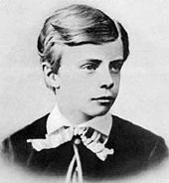
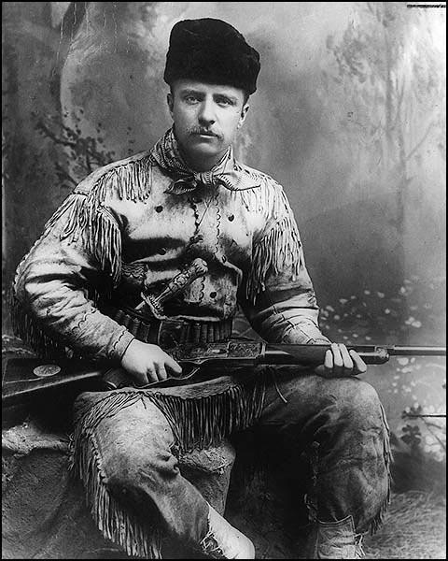
Theodore Roosevelt
Wealthy NY family
Severe asthmatic but mastered horseback riding, marksmanship, boxing, and wrestling
Republican (but increasingly progressive) - 3 terms in NY state assembly, NYC police commissioner, assistant secretary of US Navy, NY Governor, VP to McKinley
1901 – McKinley assassinated → Teddy as POTUS (youngest at 42)
26th POTUS 1901-1908

Slide 5
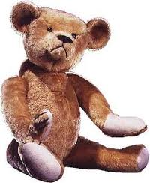
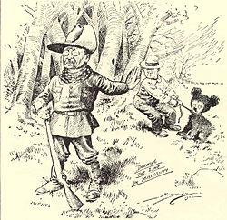
Fun Fact!
The “teddy bear” is named after Teddy Roosevelt!
Refused to shoot a bear because it was unsportsmanlike, however instructed that the bear be put out of its misery (clubbed)
Toymaker Morris Michtom created a stuffed bear and called it “Teddy’s bear”
Roosevelt gave permission to use his name → toys were an immediate success

Slide 6
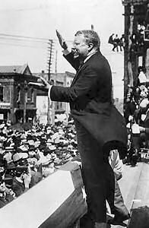
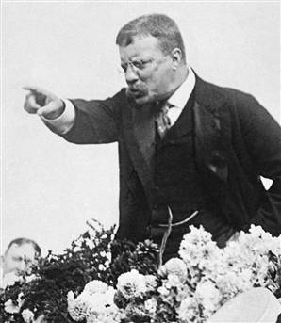
Teddy’s Use of the Bully Pulpit
Steward: a person who acts an agent for others
Believed the POTUS should be a “steward of the people” – POTUS and fed gov’t are responsible for national welfare
Bully Pulpit
An office of high ranking that permits the holder to speak out and be heard → shape legislation and policies
“It is the duty of the president to act upon the theory that he is the steward of the people, and to assume that he has the legal right to do whatever the needs of the people demand, unless the Constitution or the laws explicitly forbid him to do it.”

Slide 7
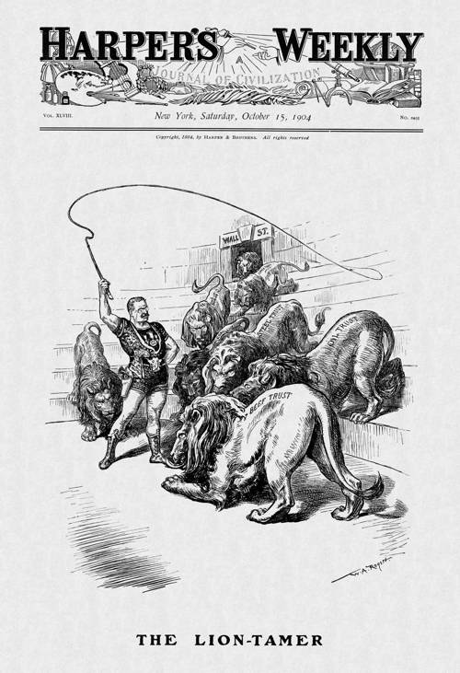
Federal Power and Teddy Roosevelt
Roosevelt’s Square Deal: progressive reforms to provide equal opportunity to all Americans
Used his presidency (his “bully pulpit”) to end big business rule
Sherman Antitrust Act of 1890 banned monopolies… but was hard to enforce and monopolies continued to grow.
Roosevelt → Trustbuster: good and bad trusts (monopolies) should be broken apart → used SCOTUS to interpret the law and apply it to illegal monopolies
Northern Securities Railroad – dissolved by Supreme Court
American Tobacco v. US – broke tobacco monopoly into smaller companies

Slide 8
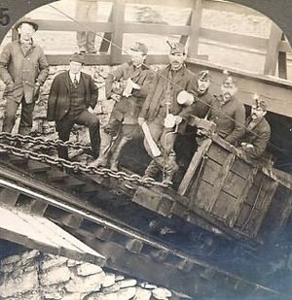
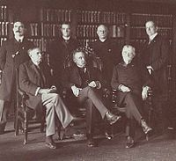
Federal Power and Teddy Roosevelt
1902 Anthracite Coal Strike: Roosevelt brought management and strikers to DC to compromise (arbitrator - federal commission)
1) federal gov’t would intervene in big business issues if threatening the public welfare
2) reflected the progressive belief that disputes could be settled by efficient arbitration
Railroad Regulation
Elkins Act in 1903 – no more railroad rebates (refunds) to businesses and railroads must inform the public if rates changed.

Slide 9
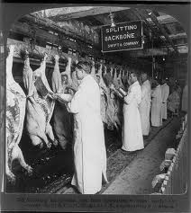
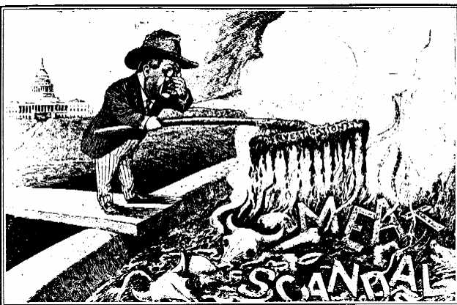
Regulating Food and Drugs
Roosevelt disgusted by practices detailed in Sinclair’s The Jungle → created commission to investigate meat industry
Meat Inspection Act of 1906 – cleanliness requirements and federal meat inspection program
Did not require date-of-manufacture to printed on canned goods

Slide 10
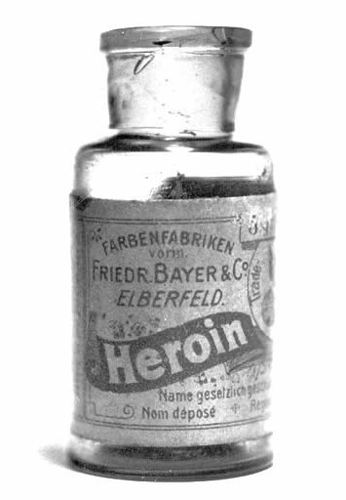
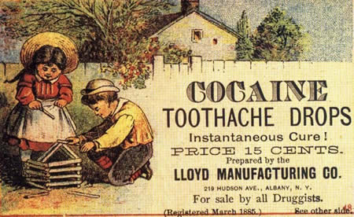
Regulating Food and Drugs
Food and drug ads claimed to do everything from cure cancer to grow hair
Popular medicines contained opium, cocaine, and alcohol
Pure Food and Drug Act of 1906 – products must have clear labels detailing ingredients and actual effects
did not prohibit/ban harmful ingredients

Slide 11
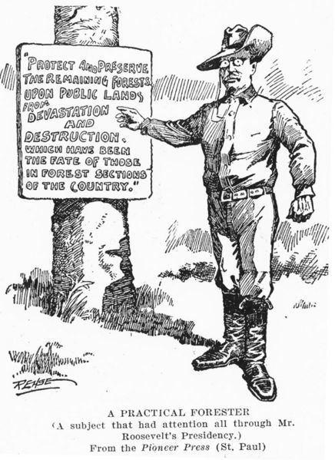
Conservation and Natural Resources
By the late 19th century, America had exploited its natural resources/environment
Water pollution, deforestation, mines, logging floods
Roosevelt believed in conservation – some natural areas should be preserved while others cultivated for economic resources
Compared to preservation – existing natural areas should be maintained and not cultivated
National Reclamation Act of 1902 – funded irrigation projects and clean water practices in the West (Roosevelt Dam and the Shoshone Dam)

Slide 12
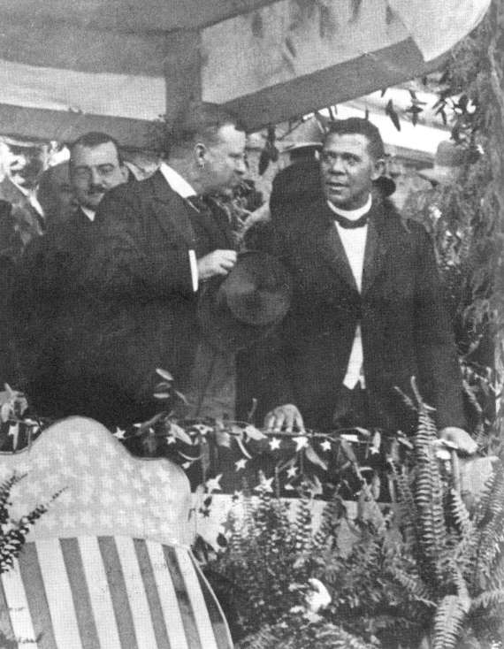
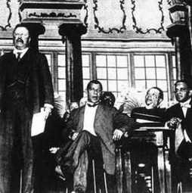
Roosevelt and Civil Rights
Failed to support civil rights for African Americans on a large federal scale
Invited Booker T. Washington to DC to symbolize his support for civil rights
Did not impress more radical civil rights activists (Team Du Bois)
Claimed Washington was the “white man’s black man” – the least threatening civil rights activist at the time
Civil rights for blacks found little support from the federal government of the Progressive Era.

