Slide 1
THE PROGRESSIVE ERA
American History II - Unit 2

Slide 2
Review
In what ways did Americans find recreation and leisure at the turn of the 20th century?
Playgrounds, amusement parks, spectator sports, bikes
How did changes in the printing and newspaper industries contribute to increased distribution of communication?
Cheap, durable paper + fast electric printing presses = more affordable and abundant newspaper/magazines
Use of sensational headlines and exaggerated stories
In what ways was consumerism encouraged at the turn of the 20th century?
Advertisements
Rise of shopping centers, department stores, and chain stores
What types of Americans were benefiting from and participating in advancements in technology, communication, and consumerism?
Mostly middle and upper class Americans with expendable income

Slide 3
2.2 – EDUCATION, SEGREGATION & DISCRIMINATION

Slide 4
Expanding Public Education
Despite earlier reforms in education, after the Civil War…
Many school-aged children did not attend school
Most left within 4 years
Few attended high school
Early 20th century education reformers viewed education as…
For the student, not the teacher
The means to prepare students for participation in civic life
A training ground for employment and economic advancement
A way to assimilate immigrants into American society
A key aspect of a stable and democratic nation

Slide 5
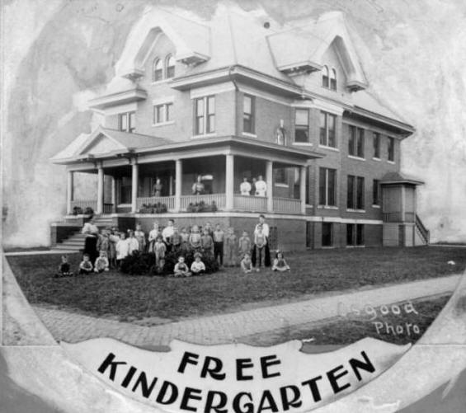
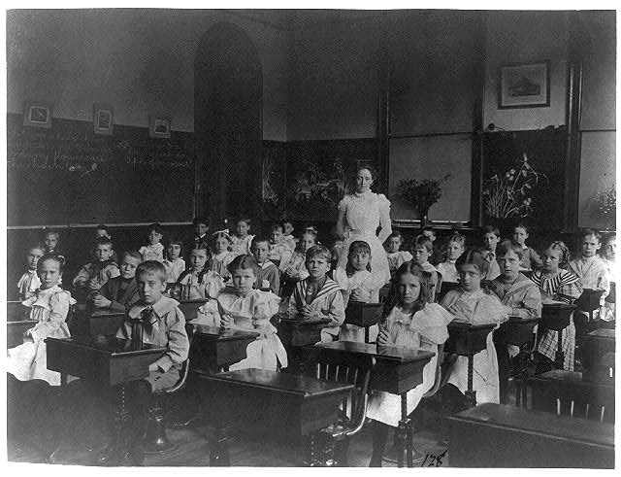
Expanding Public Education
By 1895, laws required compulsory school attendance for 12-16 weeks for children 8-14
Compulsory – mandatory
By 1900, kindergarten (for youngest students) added to public school systems

Slide 6
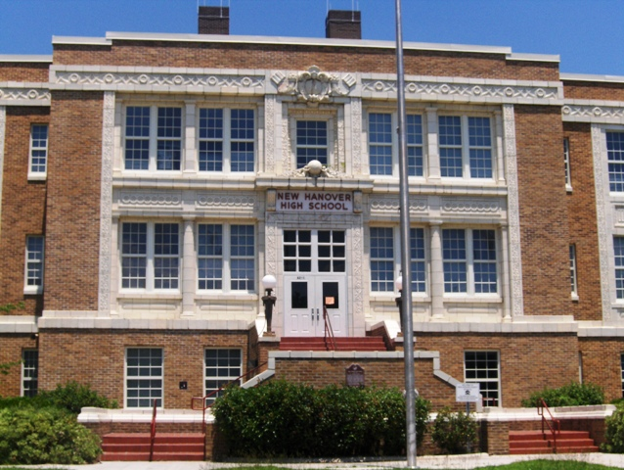
Expanding Public Education
Industrialization → high demand for skilled workers (technical and managerial)
By 1900, high schools…
Were attended by over 1 million children
Expanded the academic curriculum to include science, civics, and social studies
Added vocational courses in secretarial work (females) and drafting, carpentry, and mechanics (males)
New Hanover High School
Wilmington’s first High School (Opened 1898) (Current Building since 1928)

Slide 7
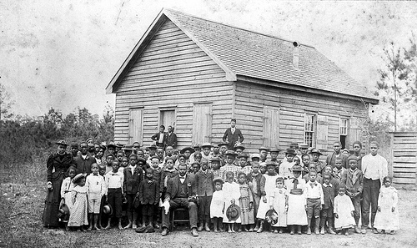
Disparities in Education
Race disparity in elementary school attendance
62% of white children
34% of black children
Not until 1940s that public education is widely available to black children in the South
Blacks were mostly excluded from high school education.
1910 – 3% of blacks 15-19 attended high school
Wealthy blacks in the north could opt for private school

Slide 8
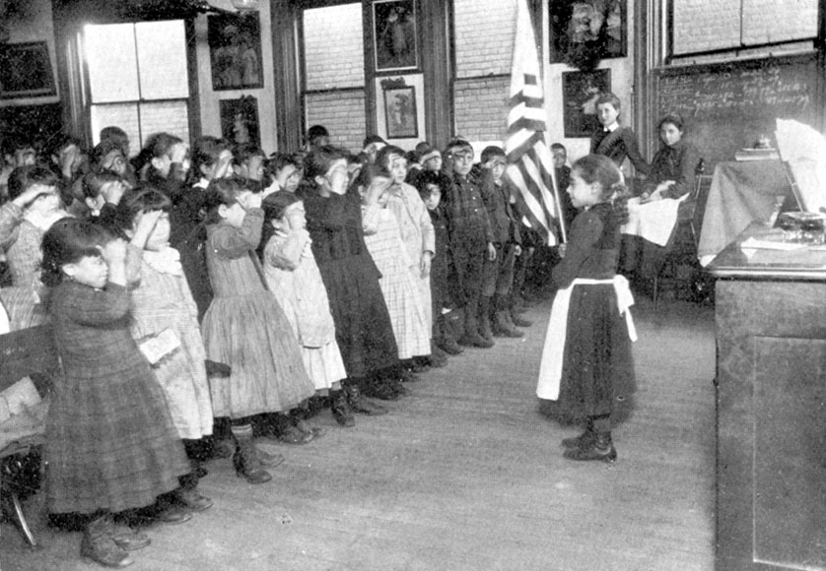
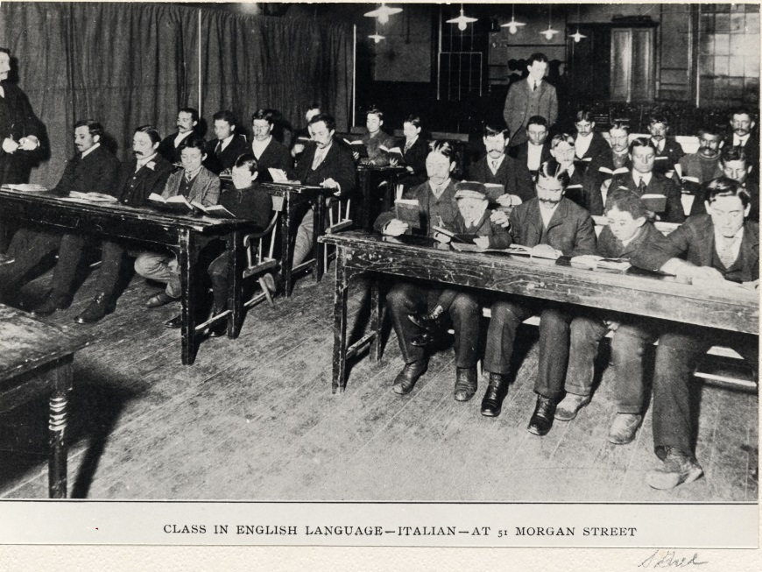
Immigrants and Education
Italian children recite
the Pledge of Allegiance
Unlike blacks, immigrants were encouraged to attend school.
Taught English and civics
Promoted nationalism and patriotism - “Americanized” immigrant children
Some immigrants resented the suppression of native customs and languages.
Jews and Catholics disliked mandatory readings from the protestant King James version of the Bible in public schools → rise of Jewish and Catholic schools
Adult and child immigrants attended night class in English and civics → citizenship test
Italian immigrants in a night class

Slide 9
Expanding Higher Education
1880-1920 – enrollment in university quadrupled
Industrialization and urbanization → new university courses
Foreign languages
Physical sciences
Psychology and sociology (new fields)
Professional schools – law and medicine
Admissions usually based on high school diploma, some schools required entrance exams

Slide 10
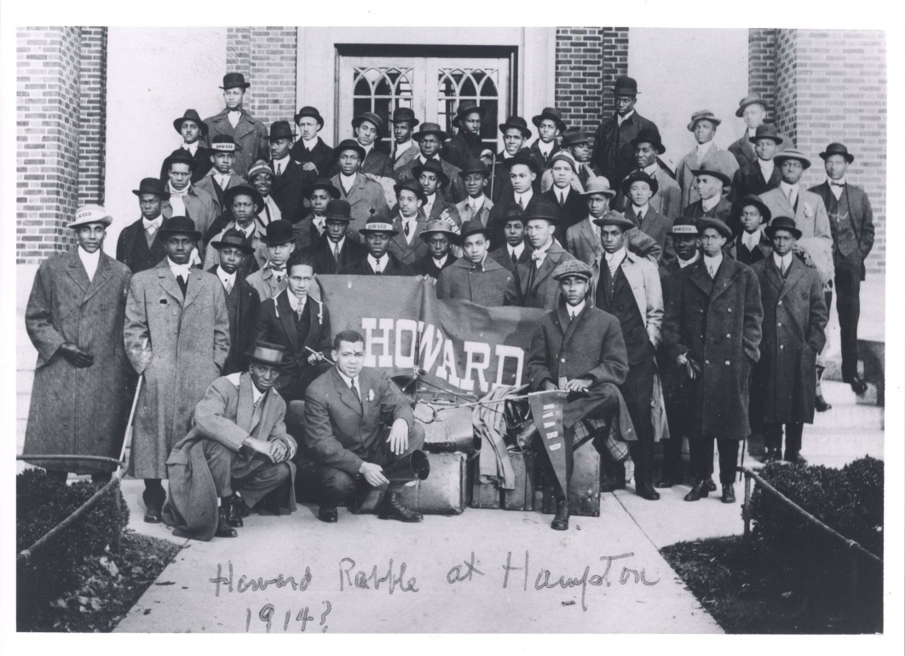
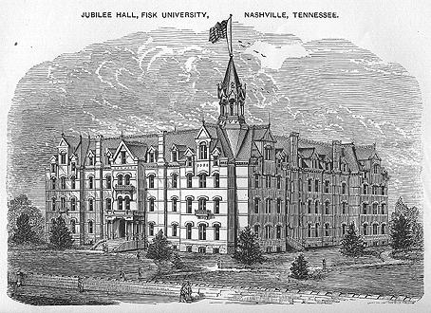
Blacks and Higher Education
Excluded from white institutions → founded Howard, Atlanta, and Fisk Universities
Help from Freedman’s Bureau
By 1900, only 4% of blacks attended university

Slide 11
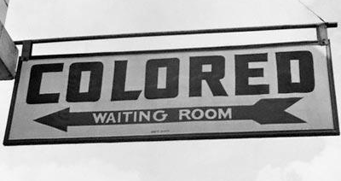
Legal Discrimination
Jim Crow laws – discriminatory laws passed by gov’ts of southern states to restrict rights of blacks
Legal discrimination – discriminatory practices outlined in legislation/laws and enforced by a gov’t.
During Reconstruction - FED legislation and Constitutional amendments gave blacks citizen and voting rights
Post-Reconstruction South - STATE and LOCAL gov’ts passed Jim Crow laws and segregation laws
Segregation – legal separation of races in public/private facilities

Slide 12
Legal Discrimination
Poll tax – fee required to register to vote
Literacy tests – reading/writing test required to register to vote
Blacks were asked harder questions, given more difficult passages, or given a test in a foreign language
Officials would pass/fail applicants as they wished
Grandfather clause – allowed voting rights if a person’s ancestors could vote prior to 1867
Loophole for white applicants who could not pay the poll tax or failed the literacy test

Slide 13
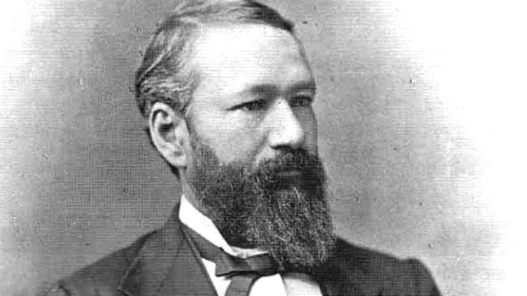
Plessy v. Ferguson
SCOTUS failed to overturn Jim Crow laws in the late 1800s and even issued decisions upholding segregation
Plessy v. Ferguson (1896) - Background
Homer Plessy (1/8th black with fair skin) sat in a “Whites Only” train car in Louisiana, refused to move, arrested → violated LA’s “Separate Car” segregation law
Judge Ferguson of the Orleans Parish upheld the arrest and segregation law
Plessy appealed, eventually suing Ferguson → picked for review by SCOTUS

Slide 14
Plessy v. Ferguson
Plessy v. Ferguson (1896) – Arguments
Plessy– LA’s segregation laws violated the 14th Amendment
“No state shall… deny to any person within its jurisdiction the equal protection of the law.” – 14th Amendment
Ferguson – states have the right to regulate railroad companies while they operated within state boundaries
“… that all railway companies carrying passengers in their coaches in this State, shall provide equal but separate accommodations for the white, and colored races.” – LA Acts 1890, No. 111

Slide 15
Plessy v. Ferguson
Plessy v. Ferguson (1896) – Decision
7-1 in favor of Ferguson
Laws requiring separate but equal facilities for blacks and whites do not violate the Constitution
14th Amendment provides equality under law BUT does not erase “distinctions based upon color”
Separate spaces for races “do no necessarily imply the inferiority of either race to the other.”
DISSENT – John Marshall Harlan, “The thin disguise of ‘equal’ will not mislead anyone, nor atone for the wrong this day done.”

Slide 16
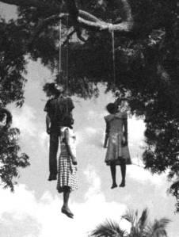
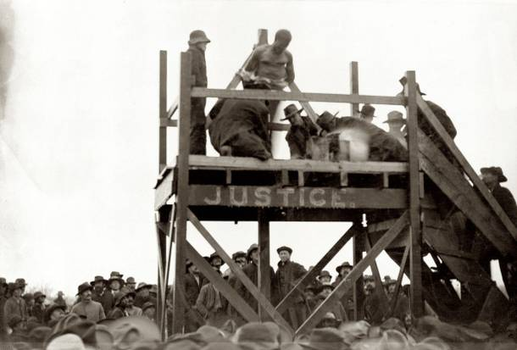
Institutional Discrimination
Institutional discrimination – discrimination that has been incorporated into a society’s structures, processes and procedures of organizations
Prejudices ingrained so deeply in a society’s culture that discriminatory actions are commonplace
Racial violence
Blacks and others who did not follow the unspoken racial rules could face violence
Lynching - public executions by a mob, often by hanging, in order to punish an alleged transgressor, or to intimidate a minority group
1882-92 – more than 1400 blacks lynched
Shot, burned, hung without trial for accused crime/transgression

Slide 17
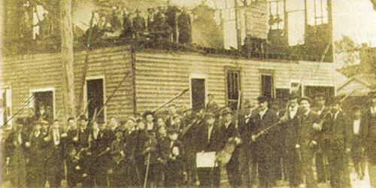
Wilmington Race Riots-1898
November 10, 1898
Over 500 whites burned the office of the “Daily Record”
14 Blacks killed
Whites took over government of Wilmington and passed “Jim Crow” laws

Slide 18
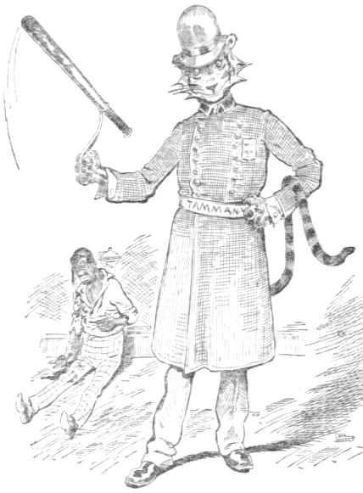
Discrimination in the North
Post-Civil War and Reconstruction – some blacks moved north to find jobs and start fresh
Discrimination existed in the north as well
Segregated neighborhoods
Discriminatory hiring practices
Exclusion from some labor unions
Race riots over competition for jobs and unfair treatment by police – NYC Race Riot in 1900

Slide 19
Discrimination in the West
Blacks, Mexicans, Asians, Native Americans faced discrimination in western states
Mexicans
Late 1800s – hired in large numbers for railroad construction, mining, irrigation projects, agriculture
Paid less than white workers in the same jobs
Debt peonage – system of forced slave labor in order to work off a debt to the employer
Declared unconstitutional by SCOTUS in 1911
Chinese
Mostly west-coast, pushed into segregated neighborhoods and schools
Chinese Exclusion Act (1882) – restricted Chinese immigration

Slide 20
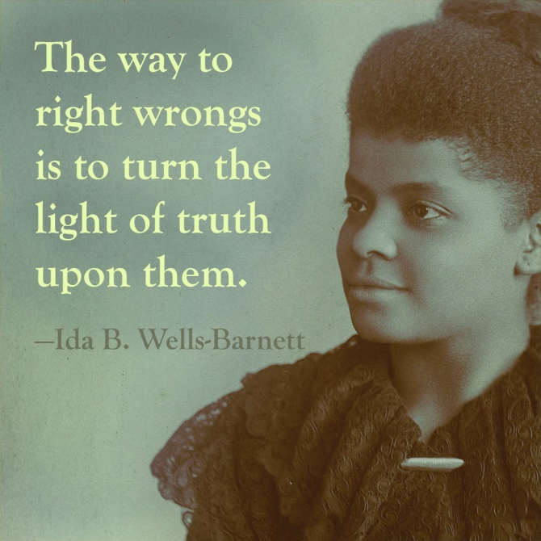
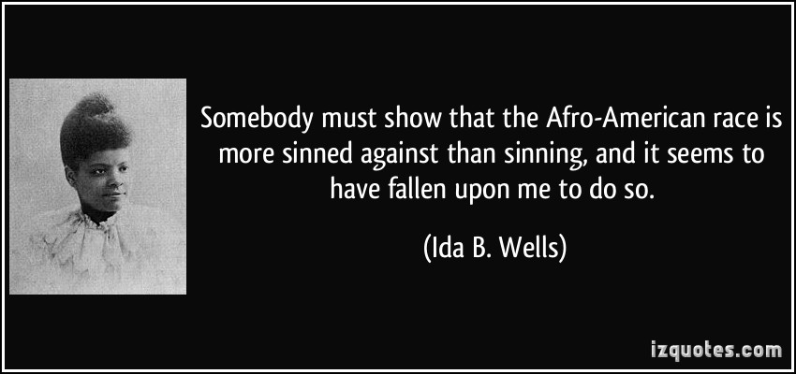
Ida B. Wells
Outspoken black activist against discrimination, especially lynching
Born into slavery (1862), later a teacher and paper editor
Raised awareness of racial injustices through writings, lecturing, and organizing for civil rights

Slide 21
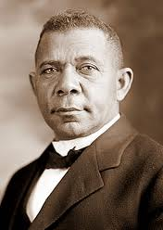
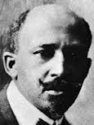
Washington and Du Bois
Booker T. Washington
W. E. B. Du Bois
Founded the Tuskegee Normal and Industrial Institute (1881) – all black training school
Believed racism would end once blacks acquired useful labor skills and proved economically valuable to society
“Wait, prove your worth, and you shall succeed.”
Founded the Niagara Movement (1905) which would later become the National Association for the Advancement of Colored People (NAACP)
Racism would end once blacks obtained a liberal arts education to join the “Talented Tenth” (% of educated blacks) and produce change through political action
“Waiting will continue oppression… act now!”
vs

