Slide 1
THE PROGRESSIVE ERA
American History II - Unit 2

Slide 2
2.1 – LIFE AT THE TURN OF THE 20TH CENTURY
https://www.youtube.com/watch?v=8hIwrklcRhM

Slide 3
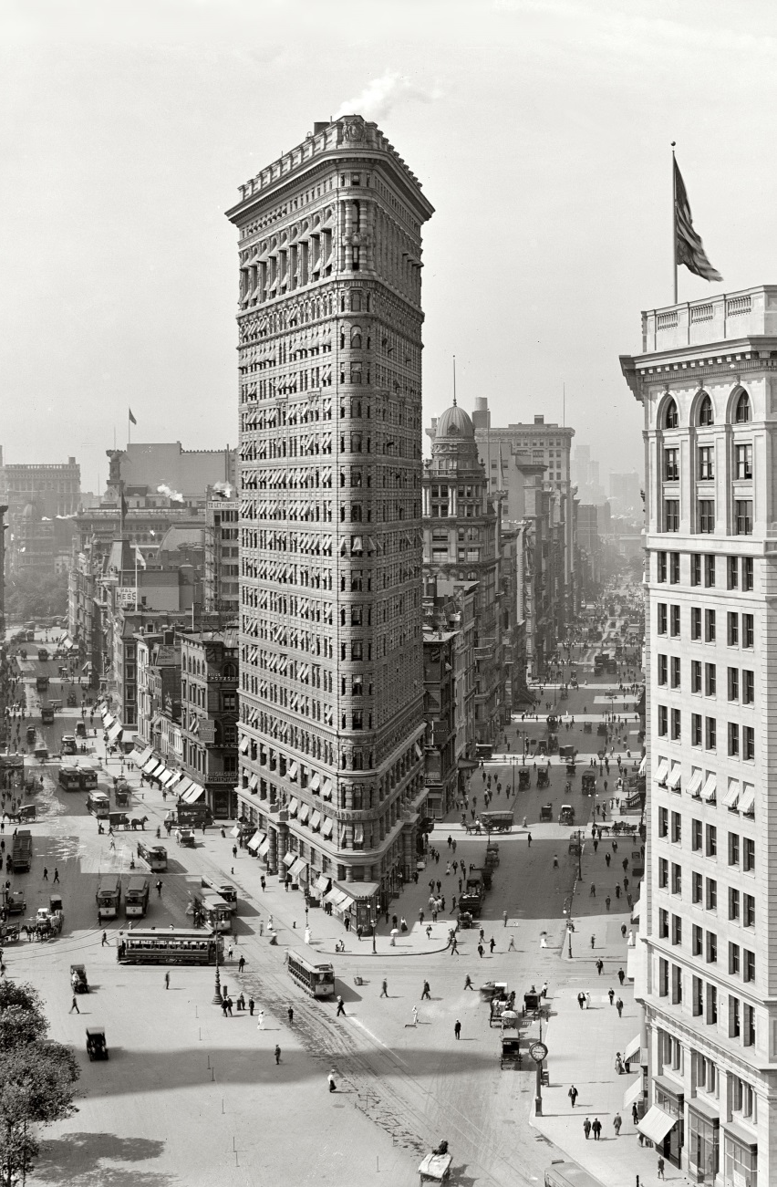
Technology Transforms Urban Life
By 1900, 40% of Americans lived in cities (rapid urbanization of the late 1800s) → how to accommodate for large city populations?
Skyscrapers
2 inventions – steel and elevators
Must be built within the confines of existing streets → unusual designs (ex: Flatiron Building in NYC)
Rise of skyscrapers → symbolic of wealthy and optimistic society

Slide 4
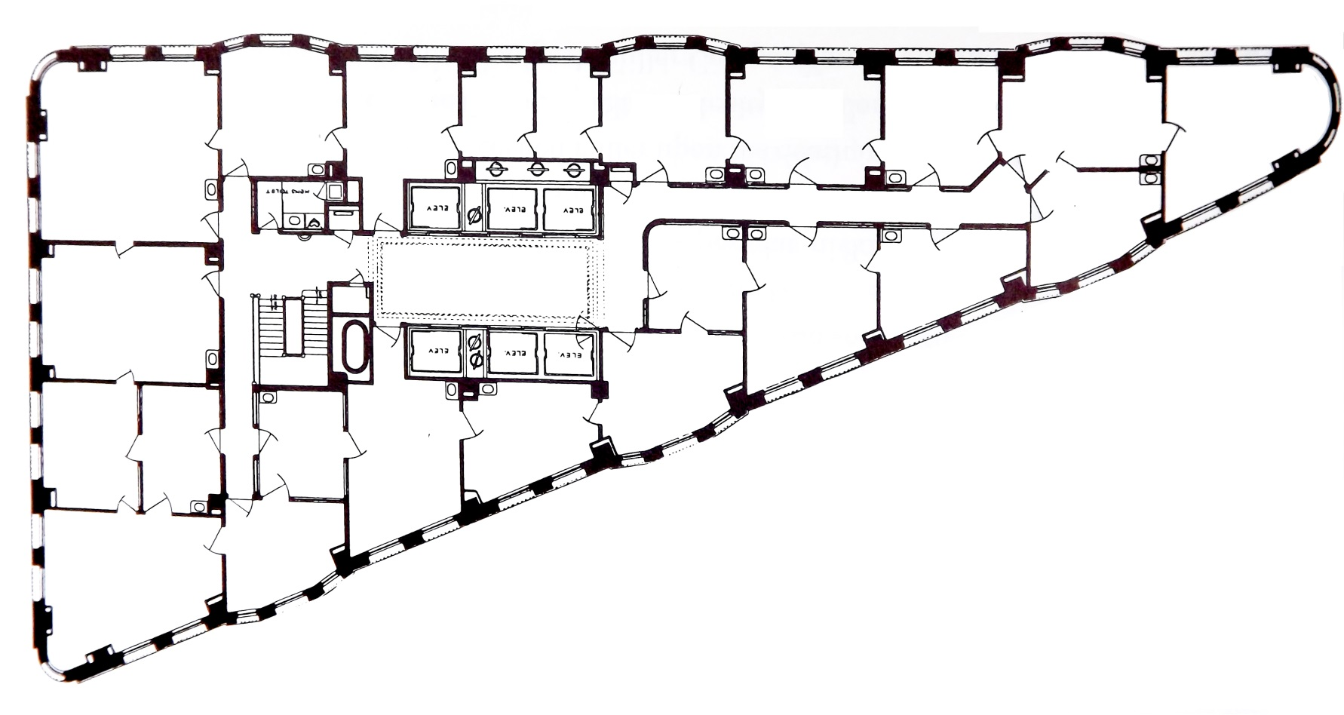
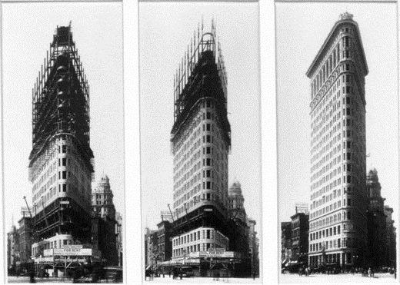

Slide 5
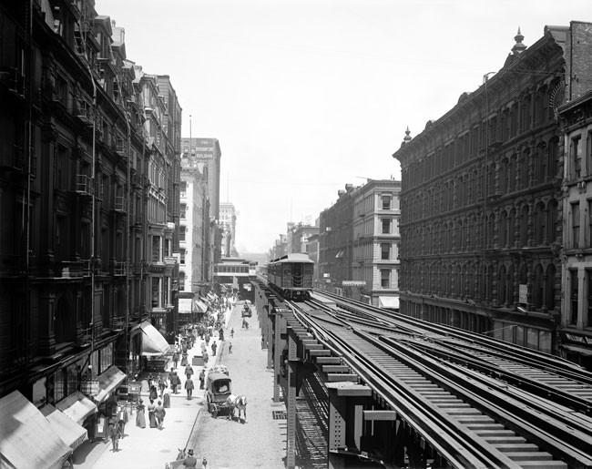
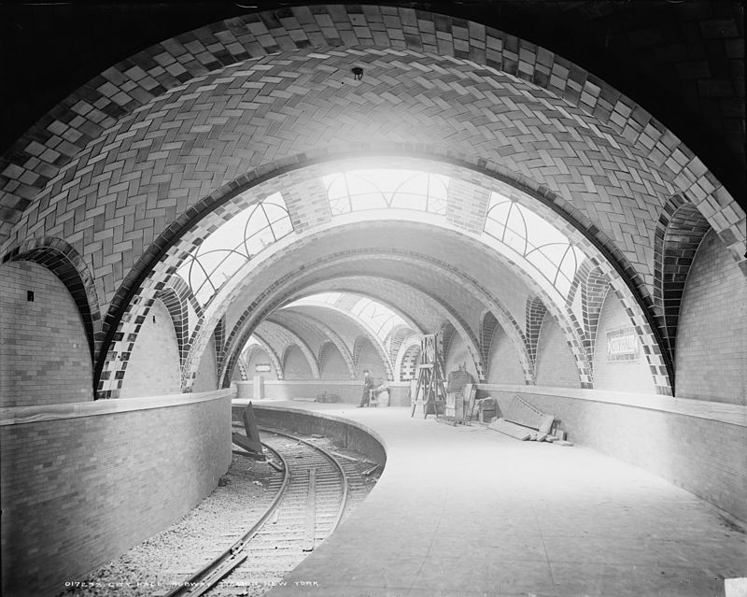
Technology Transforms Urban Life
Electric mass transit
Grids of electric streetcars (trolley cars) ran from downtown to outlying neighborhoods
Some cities built elevated streetcar routes or underground subways
Growth of “suburban” developments
Chicago’s “EL” line
NYC’s City Hall Station - 1904

Slide 6
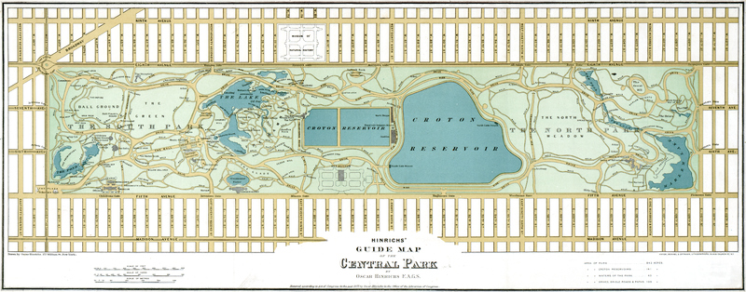
Technology Transforms Urban Life
Urban Planning
Increased urbanization → decreased “natural” areas in cities
Movement to plan urban parks to “restore sense of serenity”
Central Park in NYC – 1st landscaped public park, completed in 1873 (1875 map below)

Slide 7
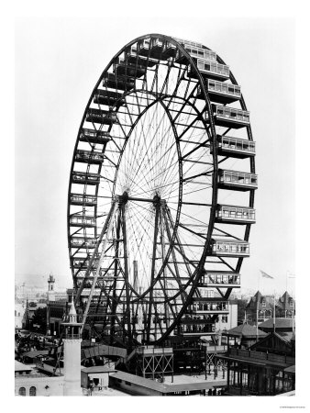
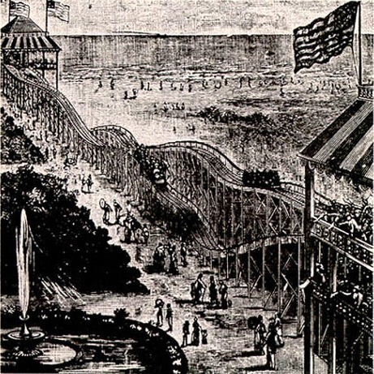
American Leisure
Rise of parks and urban planning → increased focus on recreation and leisure activities
Playgrounds and amusement parks
Increase is playgrounds and play fields in cities
Coney Island – 1st roller coaster (1884)
World’s Columbian Exposition in Chicago – 1st Ferris wheel (1893)

Slide 8
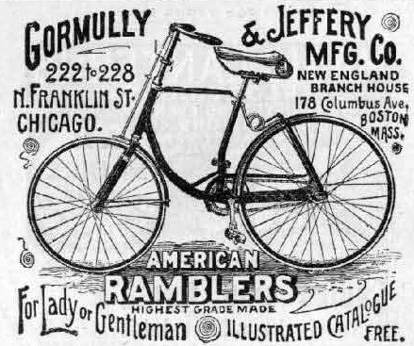
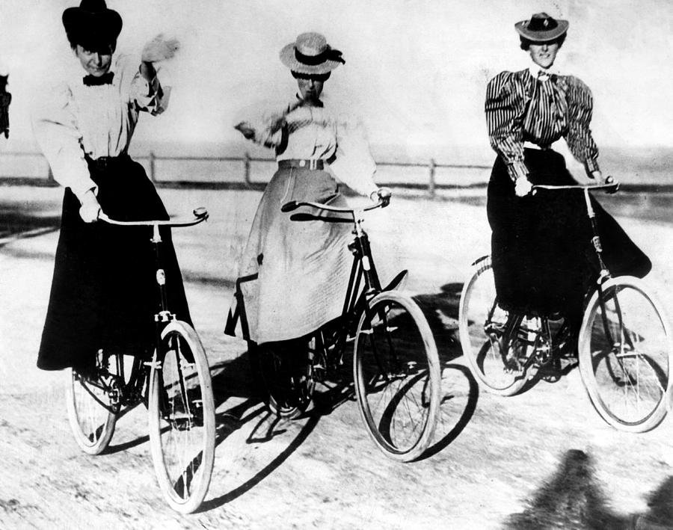
American Leisure
Bicycling
Originally large front wheel and solid rubber tire → dangerous and only for men
20th century - smaller wheels filled with air → increased popularity
Women enjoyed increased freedom on bicycles
Less constrictive attire
No “chaperone” → freedom and self-reliance

Slide 9
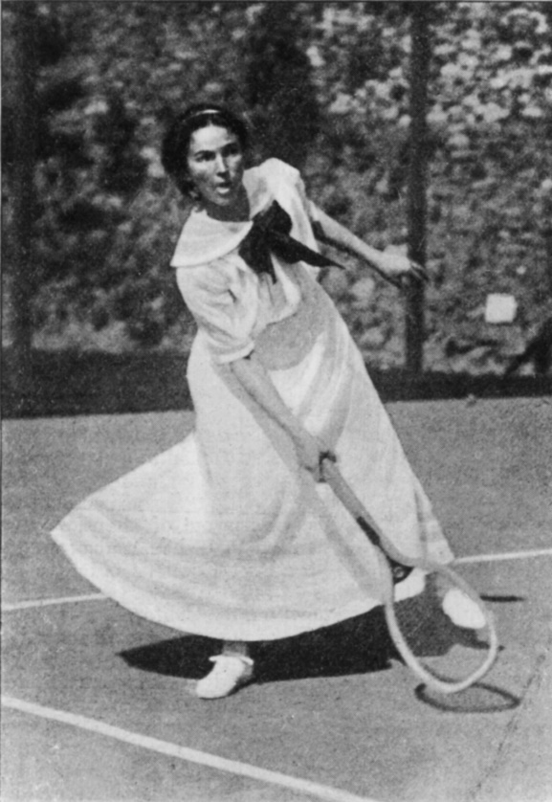
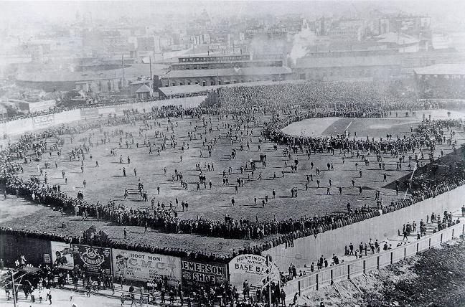
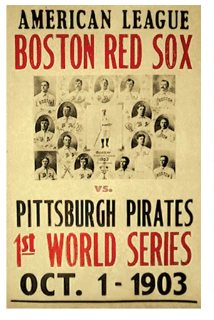
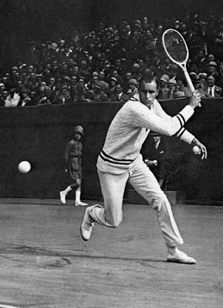
American Leisure
More time for entertainment and recreation → Rise of spectator sports
Boxing
Tennis
Adopted from Great Britain in 1870s
Sophisticated sport for middle/upper classes
Not violent – increased female participation
Baseball
1845 – first baseball clubs in NYC
1890s – standard rules, diamond-field
1903 – first World Series
Blacks formed separate leagues due to discrimination

Slide 10
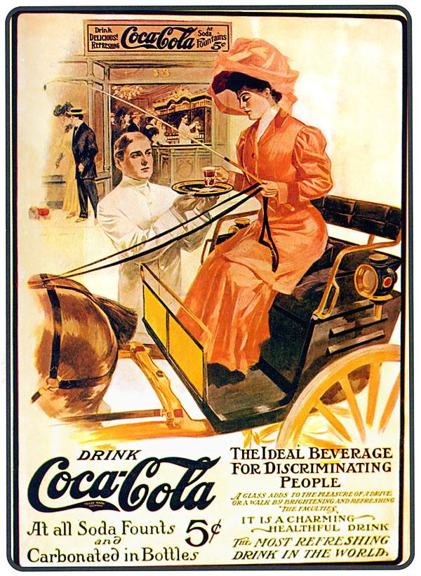
American Leisure
Industrialization → consumerism of food products with brand names
Coca-Cola (1886)
Headache remedy
Contained extracts from Peruvian coca leaves and African cola plants
Hershey’s Chocolate
1900 – 1st chocolate bar sold

Slide 11
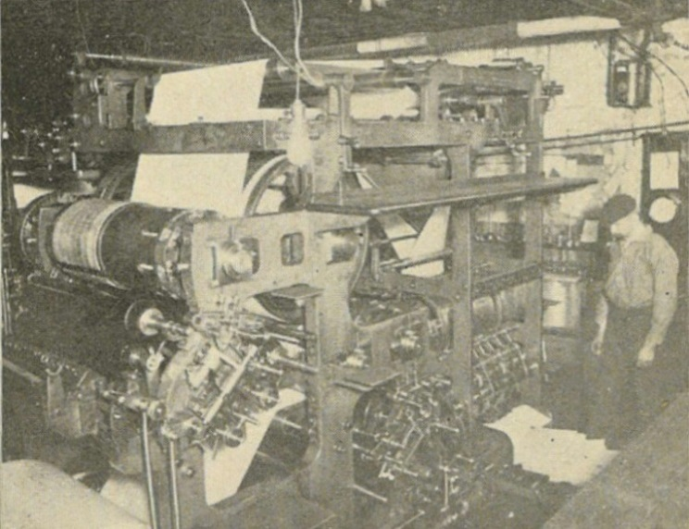
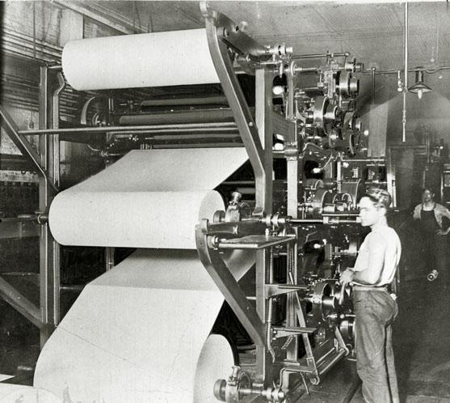
New Developments in Communication
Along with the railroad, new technological advancements increased the speed of communicating information
Printing
1890 – literacy rate growing
Growing demand for books, newspapers, magazines
Mills began to produce bulk cheap paper from wood pulp that could withstand high-speed printing presses
Cheap, durable paper + fast electric printing presses = more affordable and abundant newspapers and magazines

Slide 12
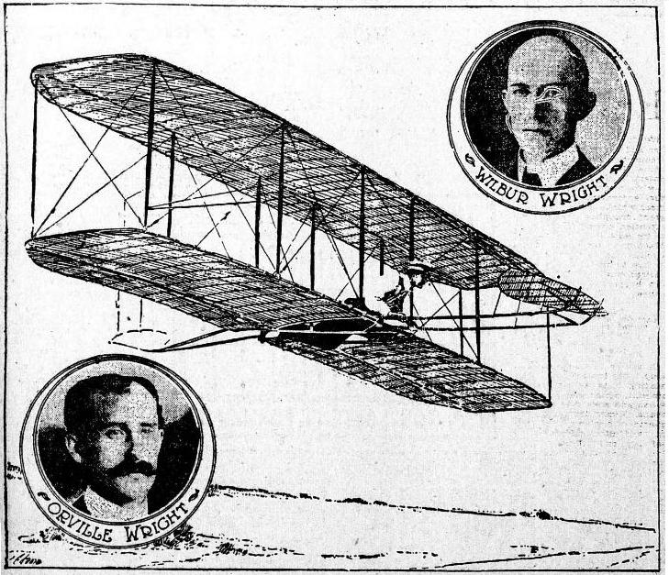
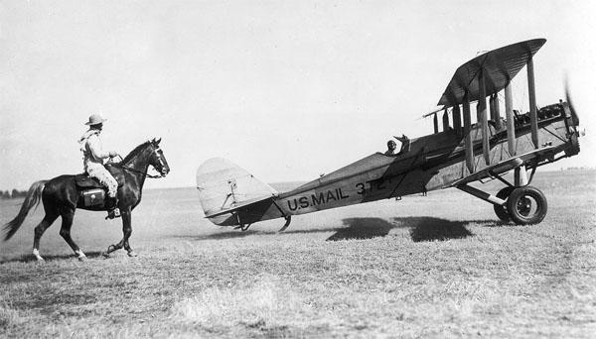
New Developments in Communication
Airplanes
Orville & Wilbur Wright – Ohio, bicycle manufacturers
Experimented with engines to keep objects aloft
Glider → 4-cylinder internal combustion engine with a propeller and biplane with 40’4’’ wingspan
December 17, 1903 – 1st successful 12-second flight at Kitty Hawk, NC
By 1905, Wright brothers increased flights to 24 miles
1920 – US gov’t established the 1st transcontinental airmail service

Slide 13
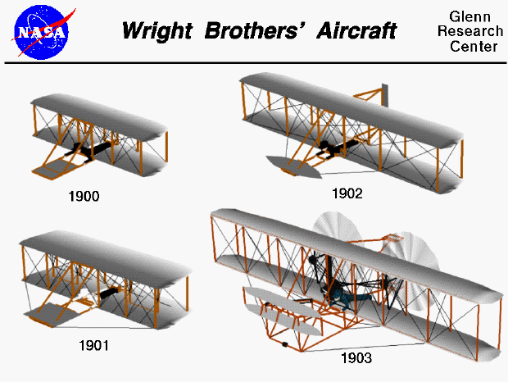
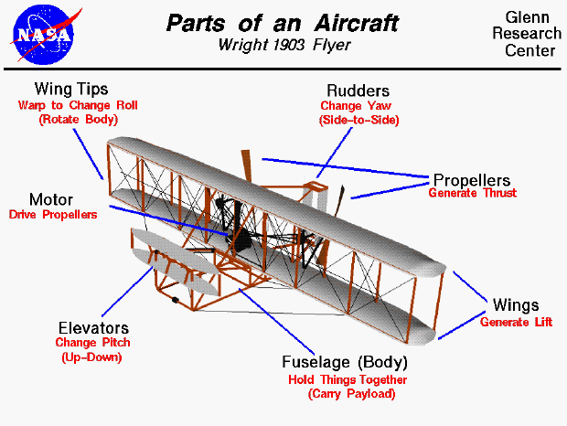

Slide 14
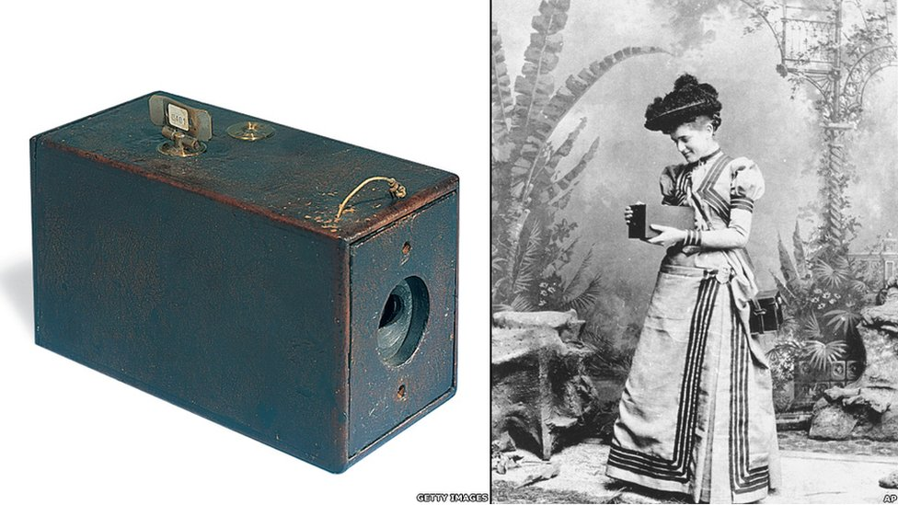
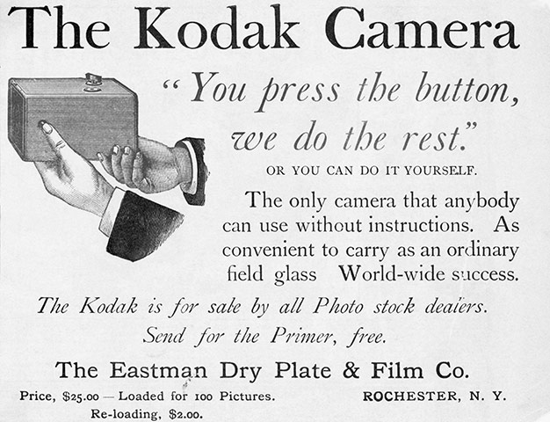
New Developments in Communication
Photography
Professional activity – only pictures of stationary subjects, heavy/expensive equipment, had to develop images immediately
George Eastman, 1888 – Kodak camera
$25, 100-picture roll of film
$10 – send film to get developed in Eastman’s factory, sent back with pictures and reloaded camera
Easily held and operated
Many people could use a camera recreationally
Rise of photojournalism – document events as they took place

Slide 15
Mass Circulation of Newspapers
New technologies in documenting, printing, and distributing information → newspapers used sensational headlines to attract more readers
Joseph Pulitzer – owned New York World (1883)
Pioneered large Sunday editions, comics, sports coverage, and women’s pages
Used “sin, sex, and sensation” to attract readers
William Randolph Hearst – owned New York Morning Journal (1895)
Published exaggerated tales of scandals, hypnotism, and aliens

Slide 16
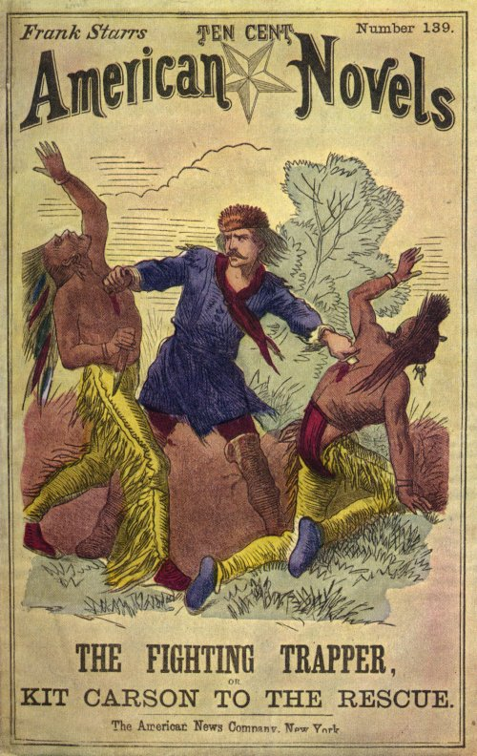
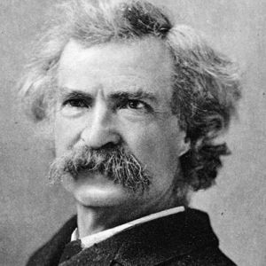
Popular Fiction
Dime novels – 10 cent books of light-fiction
Today’s “beach-reads”
Cheap and fast
Realistic portrayals of American life and/or social commentary
Mark Twain – Adventures of Huckleberry Finn
Other novelists sought to tell tales of people outside of the upper-class

Slide 17
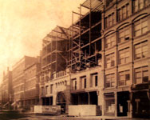
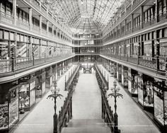
New Consumerism
Rising consumerism → new ways to sell goods
Shopping centers
1890 – 1st “shopping center” in Cleveland, OH – jewelry, leather goods, stationery shops with window-fronts
Sundays – live music encouraged people to stroll the center gazing into windows
Centers near mass transit stations to increase convenience and sales

Slide 18
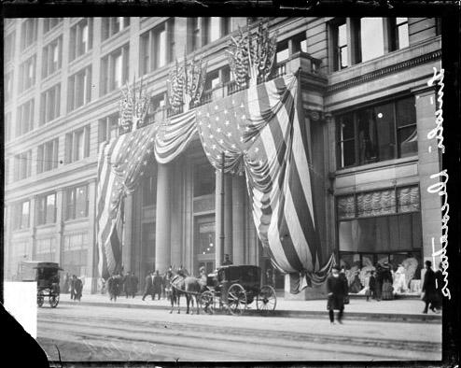
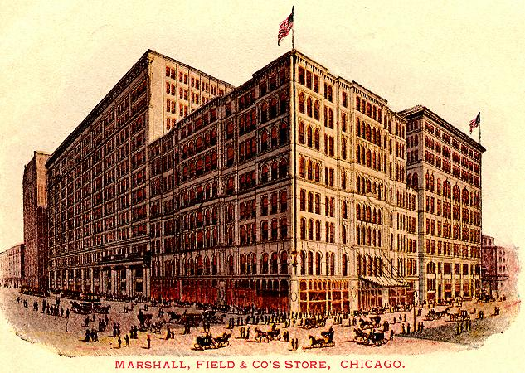
New Consumerism
Department stores
Marshall Field, store clerk in Chicago, noticed that increased attention to female shoppers → increased sales
1865 – Field opened upscale store with different departments catered to women (“Give the lady what she wants.”) → personalized service
Marshall Field’s was eventually bought by Macy’s

Slide 19
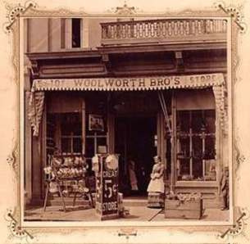
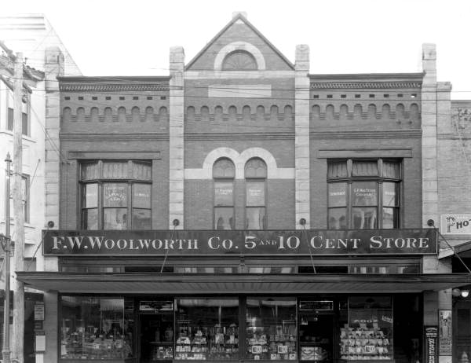
New Consumerism
Chain stores
Retail stores offering the same merchandise under the same ownership
Limited personal services (compared to department stores) and offered cheap generic goods – “the consumer would purchase it on the spur of the moment because it was only a nickel.”
1911 – almost 600 Woolworths nationwide offering a variety of goods

Slide 20
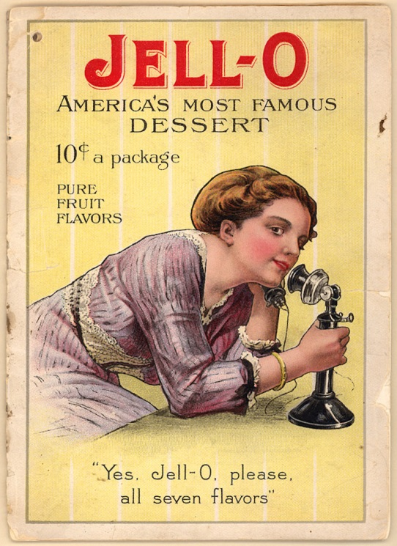
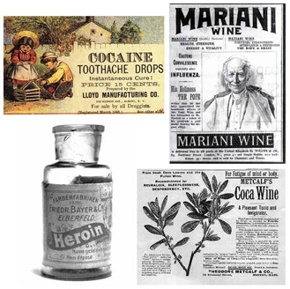
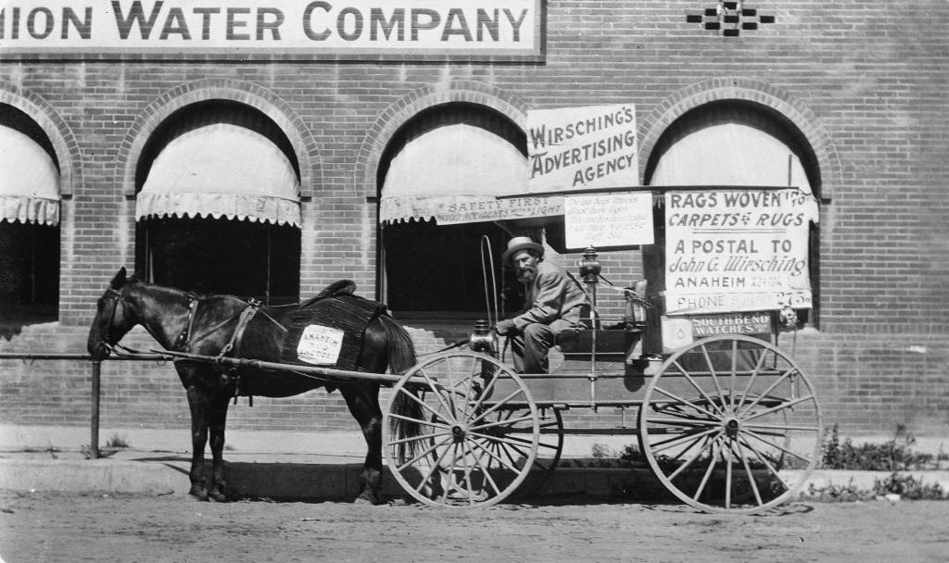
New Consumerism
Rise in consumerism → rise in advertising
1900 - $95 million spent in advertising (1865 - $10 million)
Medicines, soaps, baking powders
Printed in newspapers, magazine, on billboards, sides of barns/houses

Slide 21
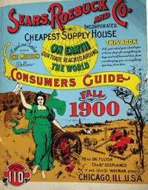
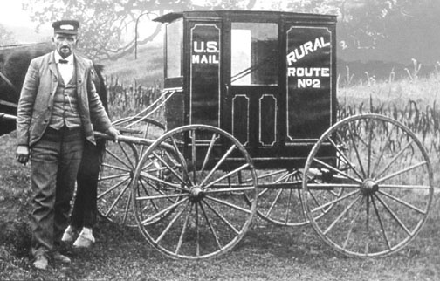
New Consumerism
Consumerism spread rapidly in cities… but what about those living in small cities? → rise of catalogs
1894 – Richard Sears distributed the first general merchandise Sears catalog
Magazine with ordering instructions (rise of credit)
Offered jewelry, watches, clothing, eyeglasses, sewing machines, firearms, bicycles, baby carriages, musical instruments…
1896 – federal Post Office established rural free delivery (RFD) – federal system to deliver mail/packages to rural areas

