Slide 1
EXPLORATION & COLONIAL AMERICA
American History I - Unit 2
Mr. Duncan

Slide 2
2.1 - EARLY AMERICA
AH1.H.3.1: Analyze how economic, political, social, military, and religious factors influenced European exploration and American colonial settlement

Slide 3
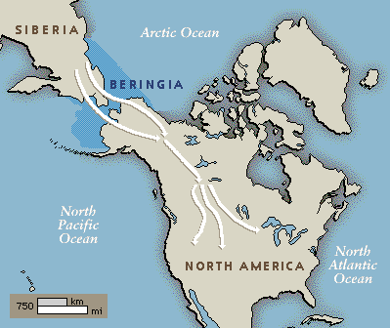
Populating the Americas
First people migrated to North America from NE Asia as early as 22,000 years ago
Beringia land bridge by foot, boats
Nomadic hunters and gatherers
Nomadic (moved around constantly) because food depended on geography

Slide 4
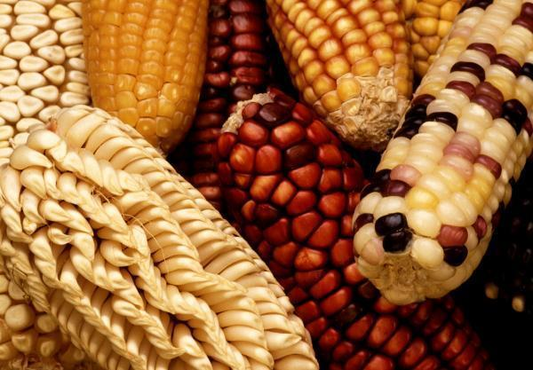
Agriculture Develops
10,000 to 5,000 years ago, agricultural revolution in central Mexico → emergence of crops (maize, gourds, pumpkins, peppers, beans, etc)
Why was developing agriculture so game-changing for civilization?
Agriculture = the ability to remain in one location → evolution of stable and complex societies/civilizations

Slide 5
North American Cultures in the 1400s
Why do you think early American cultural areas developed the way they did?
***Geography affects settlement patterns.***
Notes:
Societies are formed based on geographic/topographic aspects and weather patterns.

Slide 6
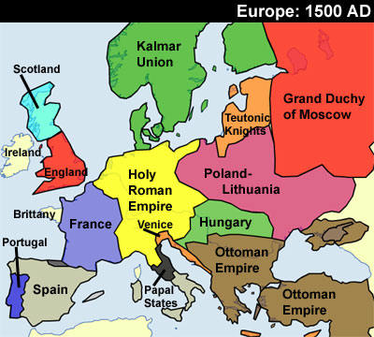
What’s Going on in Europe?
Renaissance (1400-1700s)
Renewed interest in the physical world
Scientific/technological advances
Confidence in human achievement
Reformation (1500s)
Disagreements over Christian church authority
Church vs kings/monarchs → Who is more powerful?!
Division of Catholicism and Protestantism → religious persecution (hostility towards and mistreatment of a group of people)
Why explore the new world?

Slide 7
Why Explore the World?
Pride – each European nation wanted to have the biggest worldly empire
Spread Christianity
Later – escape from religious persecution
Self-explanatory…

Slide 8
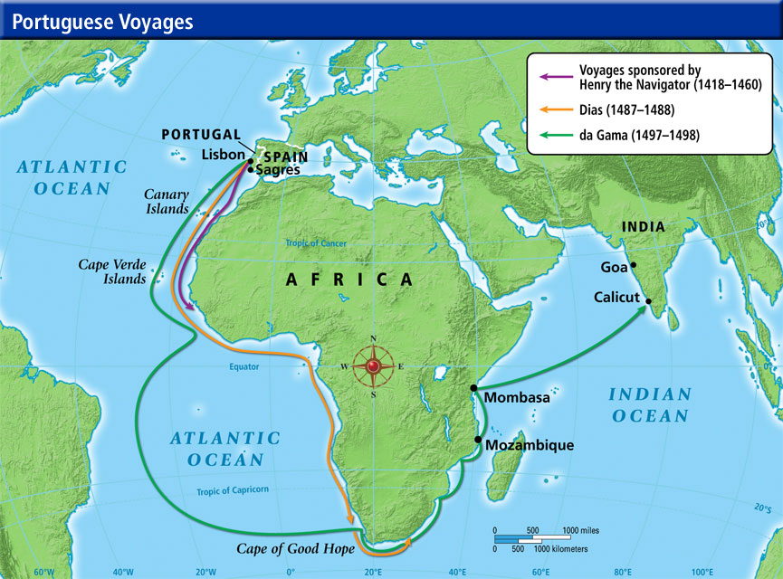
Age of Exploration
Led by Portugal – rounded the tip of Africa
Increased trade routes = more goods and more $$$

Slide 9
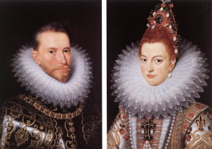
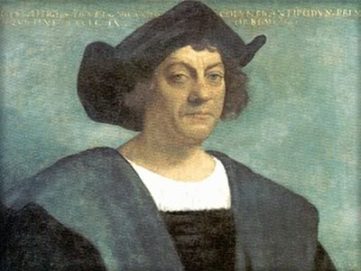
Spain & Columbus
Spain saw Portugal as a threat!
King Ferdinand and Queen Isabella just finished destroying a Muslim empire in the newly Spanish region → looking to put their name on the map (literally)
Christopher Columbus - Italian mariner, believed there was a shorter route to Asia → across the Atlantic
1492 - Spain took a chance and funded this long-shot exploration.

Slide 10
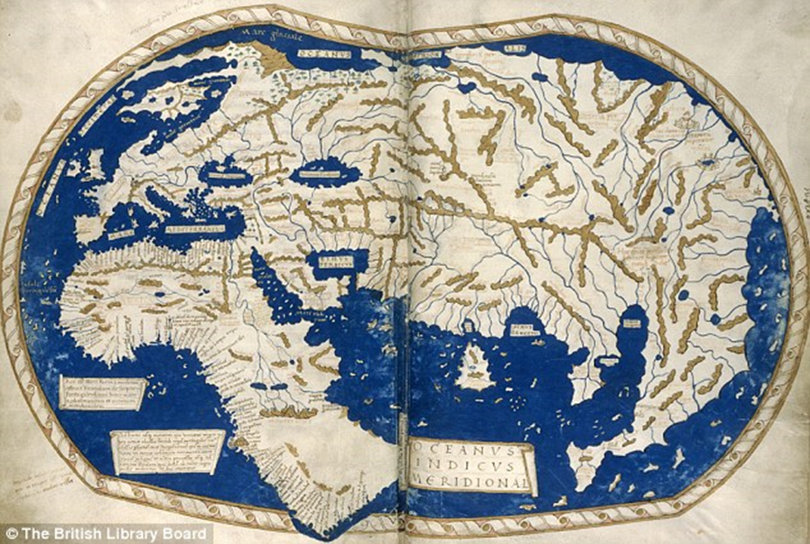
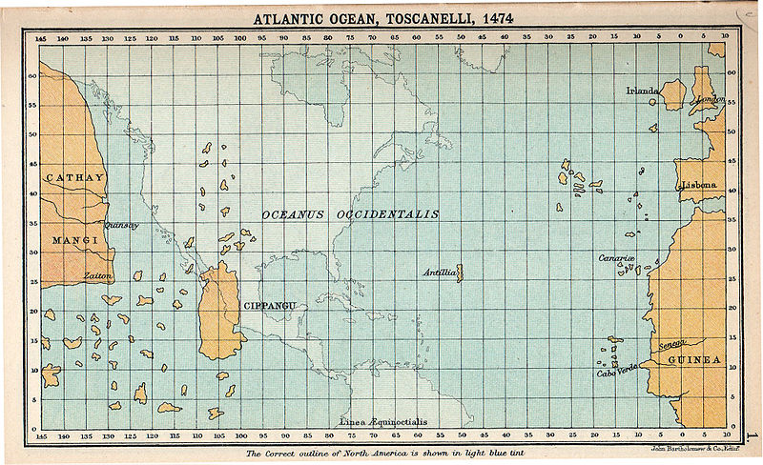

Slide 11
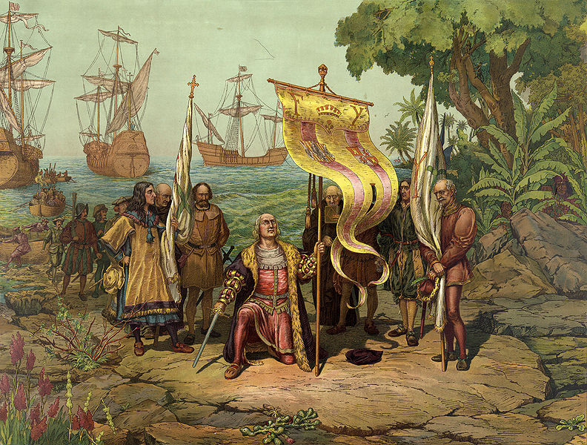
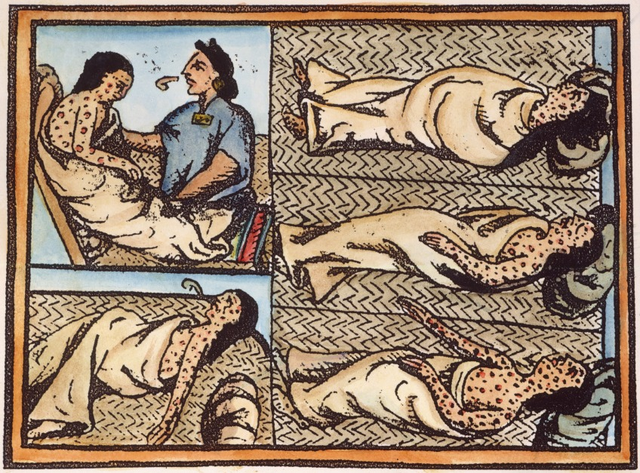
Columbus Encounters the Americas
1492, landed in the Caribbean
Renamed the island San Salvador (“Holy Savior”)
Called natives “Indians”
Brutally mistreated
Died of European diseases (measles, chicken pox, typhus)

