Slide 1
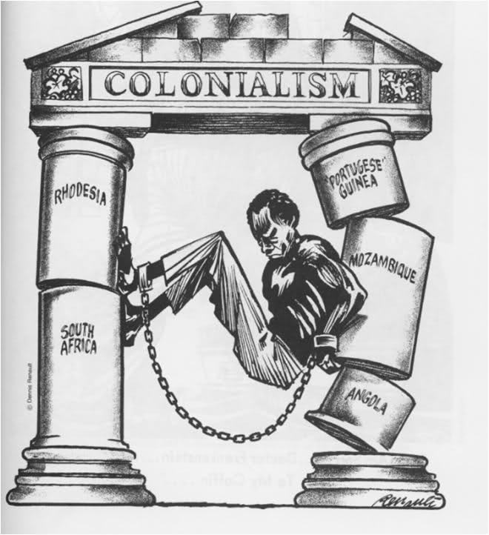
Decolonization in India & Africa
Unit 14.1 Mr. Duncan

Slide 2
Essential Question:
What was decolonization & how did decolonization impact India & Africa?

Slide 3
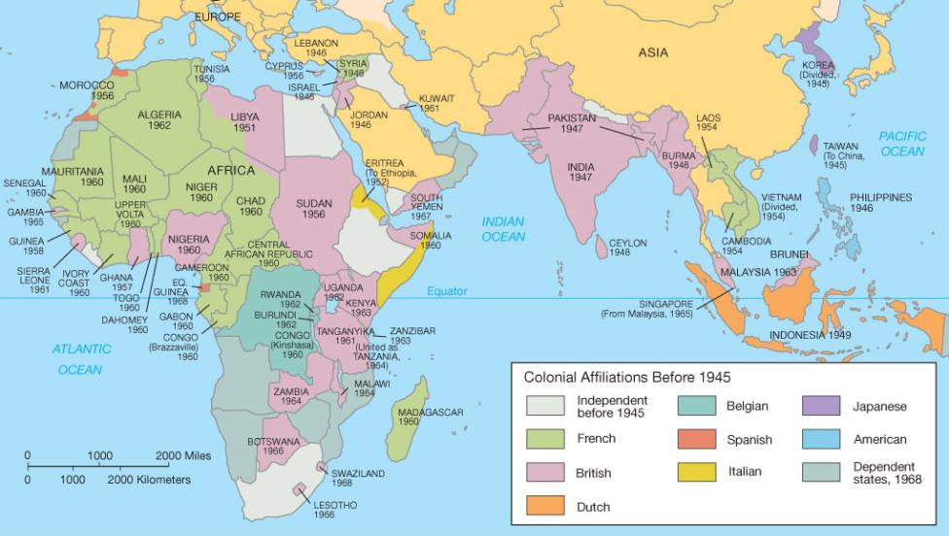
Nations in India, Southeast Asia, & Africa gained independence from imperialists (decolonization)

Slide 4
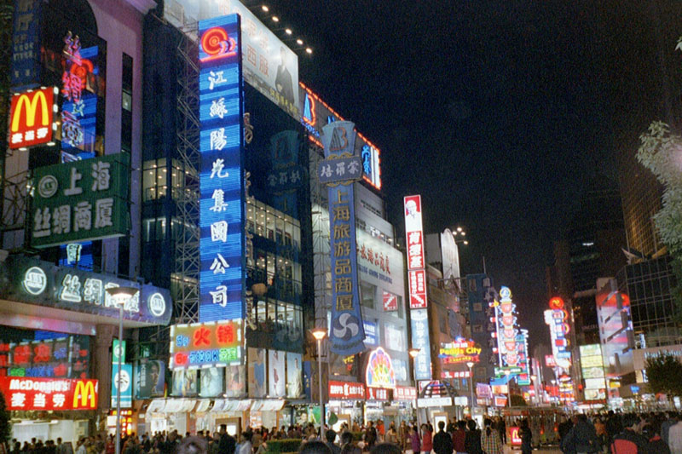
After the death of Mao Zedong in 1976, China adopted some capitalist reforms but the gov’t still strictly controlled personal liberties

Slide 5
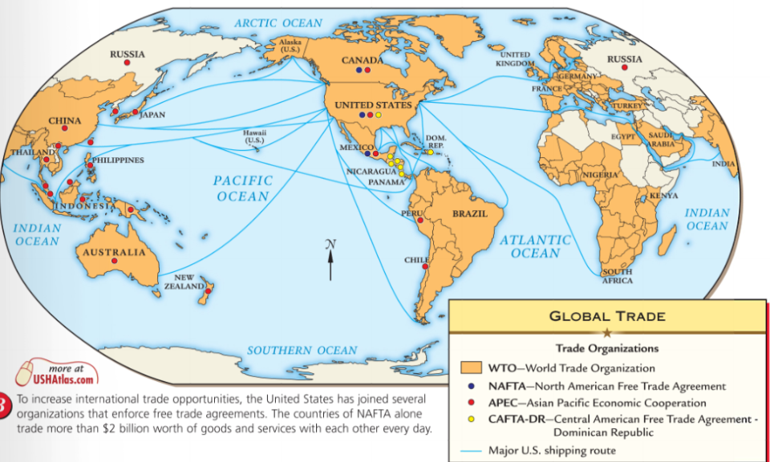
Trade became more global (known as globalism) as technology expanded, markets grew, & corporations became dominant business organizations

Slide 6
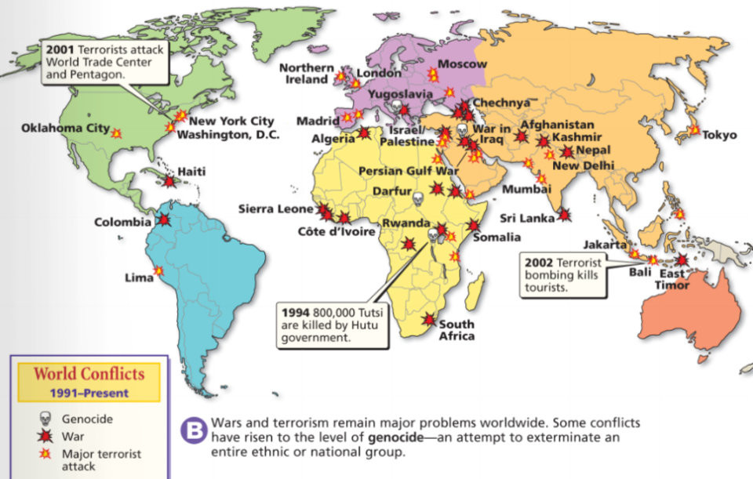
Ethnic conflicts, genocide, & terrorism increased throughout the world

Slide 7
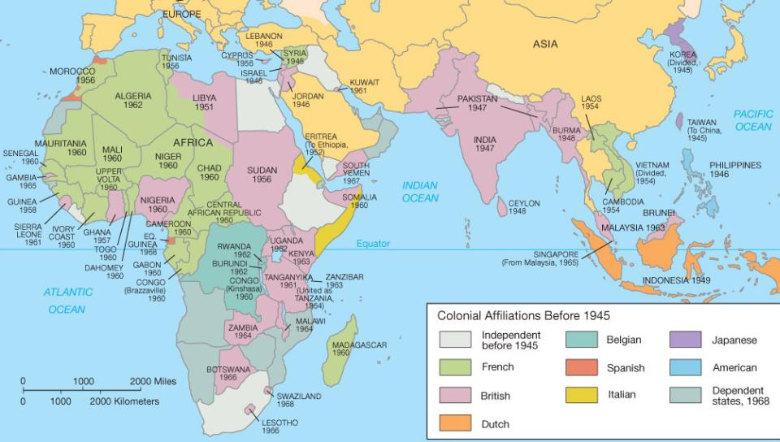
At the end of World War II, many nations in Africa & Asia gained independence from European imperialists
This trend was known as decolonization
The first major colony to gain independence was India in 1947

Slide 8
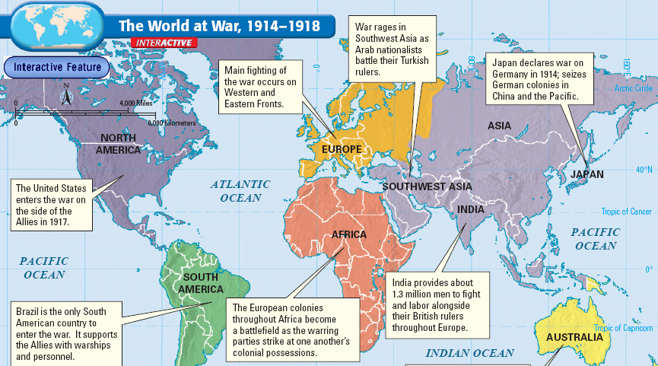
Title
During the First World War, India sent troops to fight with the British against the Central Powers in Europe
The British gov’t promised Indians self-rule as a reward for participating in WWI
Text
When the war ended & self-rule was not granted, nationalism & demands for independence increased

Slide 9
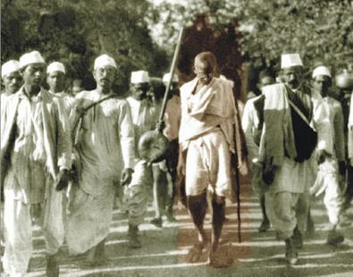
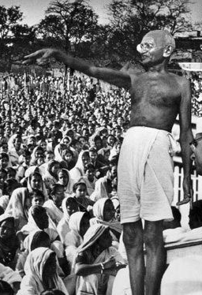
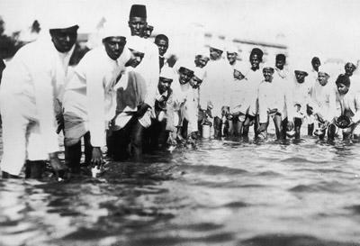
Mohandas Gandhi emerged as the leader of the Indian independence movement in the 1920s
Gandhi urged Indians to use non-violent means to achieve their goals
Gandhi’s tactics included deliberately breaking unfair British laws (called civil disobedience)
Gandhi encouraged peaceful protests & boycotting British goods in order to hurt the British colonial economy

Slide 10
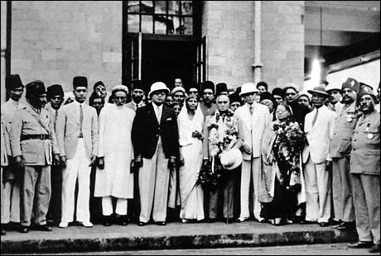
Title
In 1935, British granted India limited self-rule but not total independence
But, self-rule created tensions between the Hindu majority & the Muslim minority who feared giving power to Hindus

Slide 11
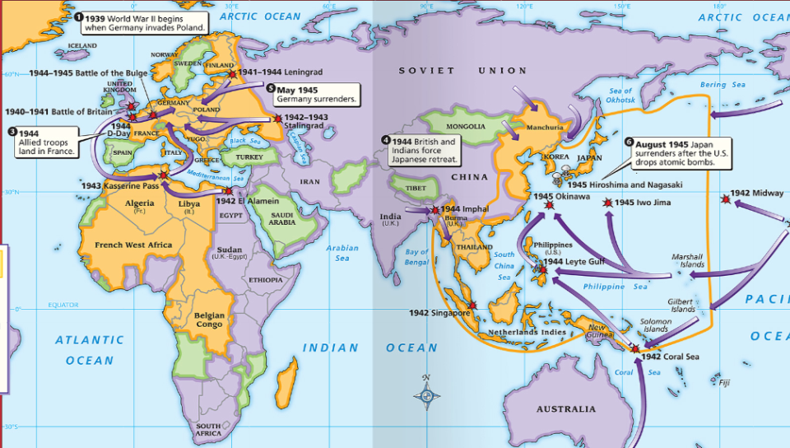
Title
When World War II broke out, Britain committed Indian troops to the war with asking India’s self-governing assembly
This led to protests & renewed calls for independence from Britain
Text
When World War II ended in 1945, Britain was in debt & ready to grant India its independence
But, violence between Hindus & Muslims made granting independence difficult

Slide 12
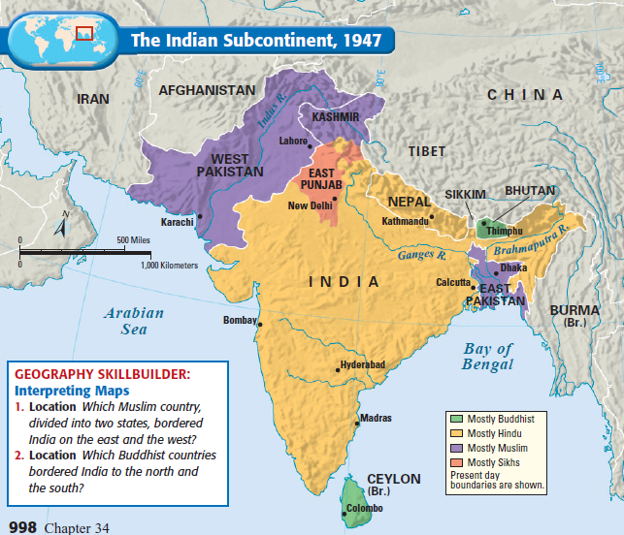
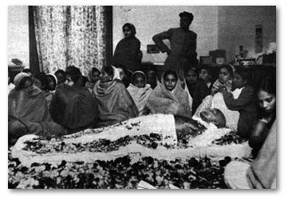
Title
In 1947, Britain agreed to a partition (division) of India & granted independence to two nations: India & Pakistan
Text
During the partition, 10 million people relocated; Violence broke out leaving 1 million dead, including Gandhi who was assassinated in 1949
Pakistan was dominated by Muslims (East Pakistan later became Bangladesh )
India was a nation made up largely of Hindus

Slide 13
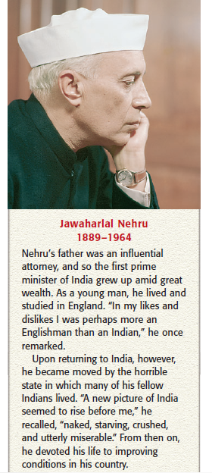
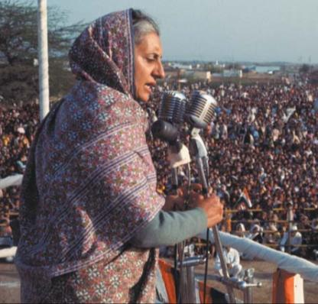
Title
In 1947, India became the world’s largest democratic nation; Jawaharlal Nehru was elected India’s first prime minister
Text
Nehru emphasized democracy, unity, & modernizing India
In the Cold War, India was a leader among non-aligned nations
In 1966, Nehru’s daughter, Indira Gandhi, was elected prime minister
Under Nehru, women & lower caste Hindus gained rights

Slide 14
Title
Text

Slide 15
Essential Question:
What was decolonization & how did decolonization impact India & Africa?

Slide 16
In the 1950s & 1960s, African colonies experienced decolonization & gained independence
The first sub-Saharan African colony to gain its independence was Ghana in 1957

Slide 17
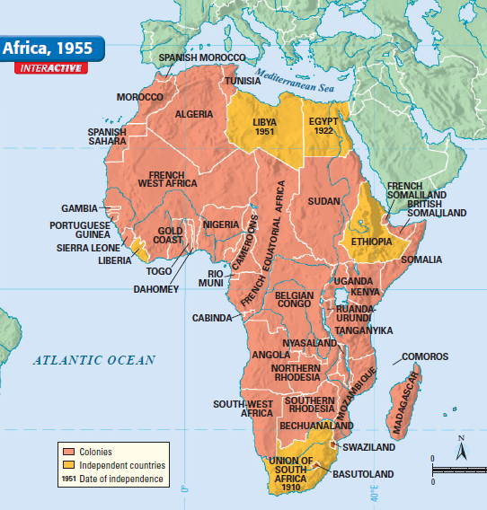
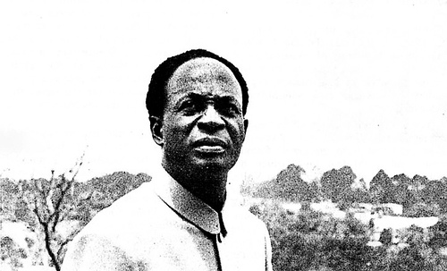
As a imperial power, Britain conquered much of Africa including Gold Coast
After WWII, Britain allowed Africans in Gold Coast to participate in local self governments
Starting in 1947, Kwame Nkrumah used Gandhi’s non-violent strategy of boycotts & strikes to pressure Britain to grant independence

Slide 18
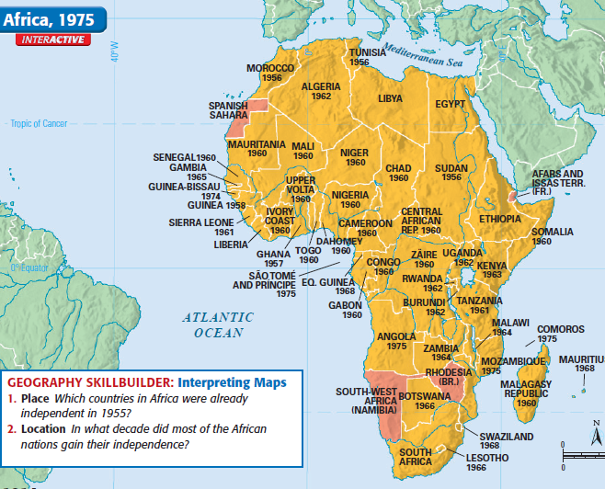
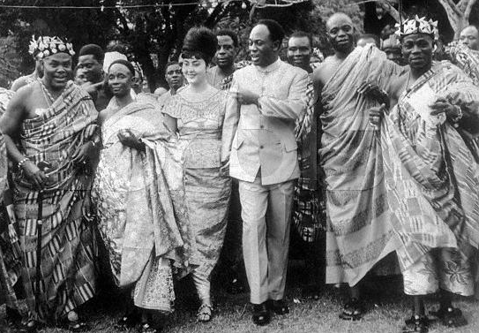
Nkrumah supported Pan-Africanism (unity among Africans) & hoped to create a “United States of Africa”
After a decade of struggle, Britain granted Gold Coast independence in 1957 & the nation was renamed Ghana
Kwame Nkrumah was elected president-for-life & began an ambitious series of road, education, health programs
In 1966, Nkrumah was overthrown & Ghana struggled between military & civilian rule until elections were finally held in 2000

Slide 19
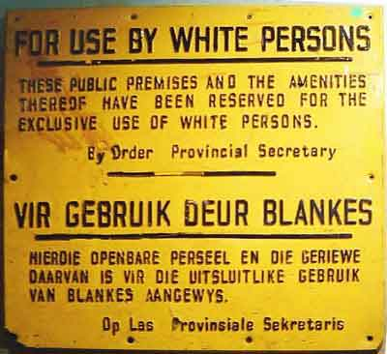
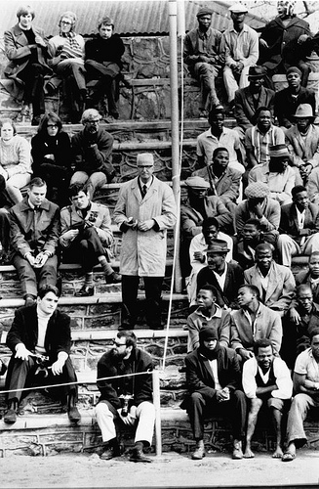
Unlike Ghana, demands for independence in South Africa were led by white colonists
When South Africa gained independence in 1931, white Afrikaners gained power & create a policy of apartheid
Apartheid laws created strict racial segregation between blacks & whites

Slide 20
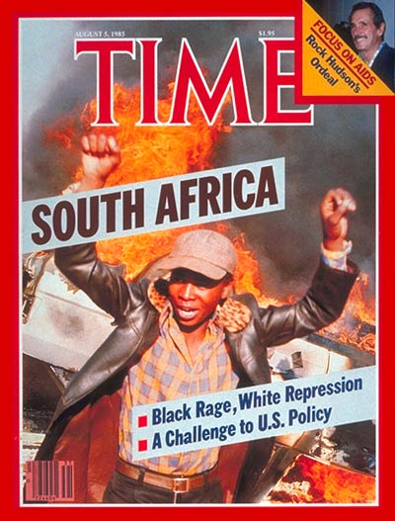
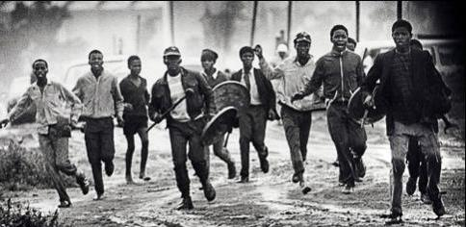
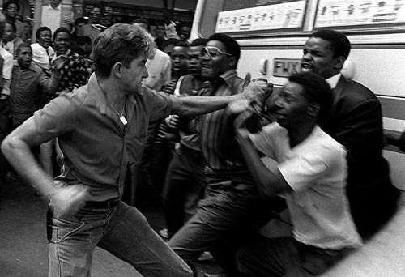
Black South Africans protested apartheid & often violent riots broke out

Slide 21
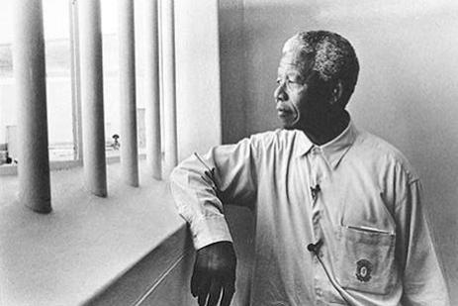
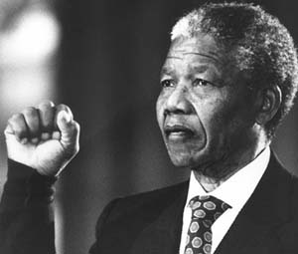
The anti-apartheid leader was Nelson Mandela
In 1964, Mandela was arrested & given a life sentence for opposing apartheid laws
In the 1980s, many foreign nations refused to trade with South Africa in protest of apartheid

Slide 22
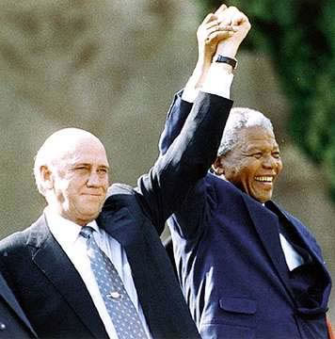
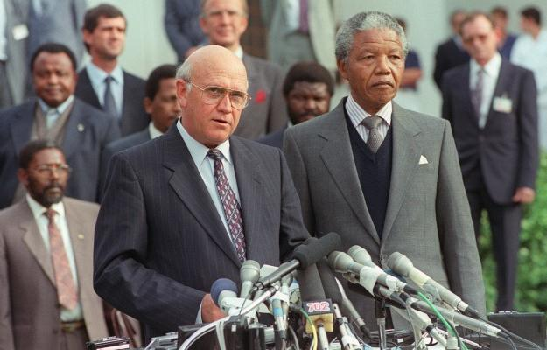
In 1990, new South African President F. W. de Clerk released Mandela from prison
South African parliament repealed all apartheid laws & announced the first multiracial election in 1994
Nelson Mandela won the election & became South Africa’s first black president
South Africans adopted a new constitution with a Bill of Rights that guaranteed equal rights for all citizens

Slide 23
Not all African independence movements ended with democracy or without bloodshed
After gaining independence, Nigeria erupted in an ethnic civil war
In Congo, a series of civil wars weakened the newly-formed nation
Ethnic divisions weakened Kenya’s government & led to violence & rule by dictators

Slide 24
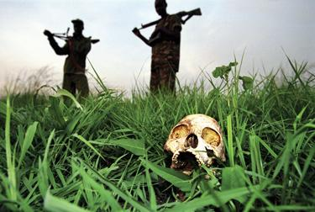
Among the worst examples of violence in Africa is the genocide (mass killings) in Rwanda & Sudan
In Darfur, the Sudanese gov’t killed up to 400,000 Muslims in an attempt to destroy an anti-gov’t rebel movement
Link to video on Rwandan genocide (3.00)
In Rwanda, ethnic conflict between rival clans led to the Hutus massacring between 500,000 & 800,000 Tutsi in 1994
Link to video on Darfur genocide (5.00)

Slide 25
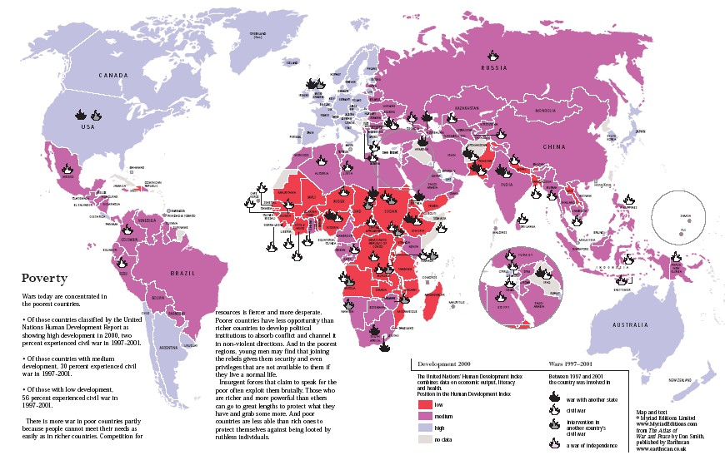
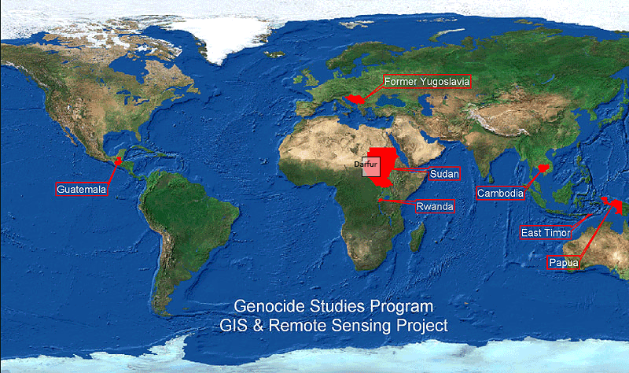
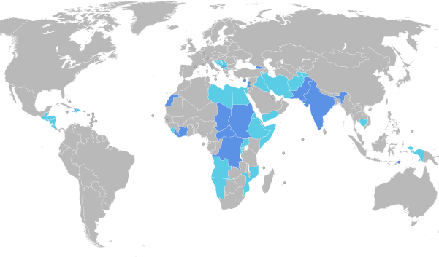
Genocide in Africa
U.N. Peacekeeping Interventions, 1945-2009

Slide 26
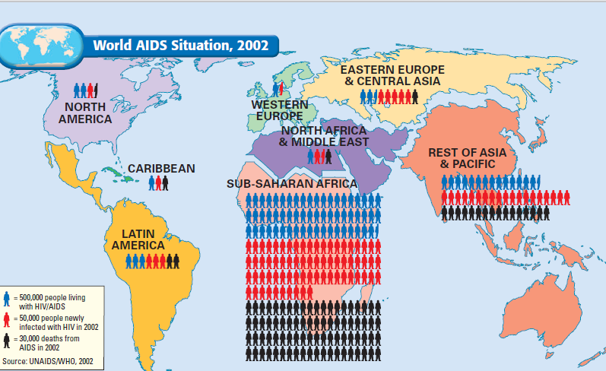
The Challenges in Africa Today
The Aids Epidemic in Africa (Link to NY Times video, 6.00)

Slide 27
The Challenges of Africa (Link to Zimbabwe video, 5.30)

